Slide 1
Community Survey for the
PARK DISTRICT OF OAK PARK
DECEMBER 2023
aQity Research & Insights
Evanston, IL

Slide 2
Table of Contents
SECTIONS | PAGE
Research Methods | 3
Sample Demographics | 4
Executive Summary | 6
Detailed Findings:
I. Overall Opinions, Strengths/Improvements Sought, and Perceived Value of PDOP | 17
II. Assessment of PDOP’s Six Core Values | 31
III. PDOP Park/Facility Usage and Satisfaction | 37
IV. Usage and Satisfaction with new Community Rec Center (CRC) | 50
V. Willingness-to-Pay: Indoor Pool | 57
VI. Awareness of PDOP’s Financial Assistance Programs | 66
VII. PDOP Program Participation and Satisfaction | 70
VIII. Sources of PDOP Information | 77
IX. Final Comments/Suggestions | 86
Appendix | 90
Sample postcard invitation for survey recruitment | 91
Survey Topline Results (questionnaire with overall frequency of responses) | 92

Slide 3
Introduction
Research Methods
These findings are based on responses from n=558 residents within the Park District of Oak Park (PDOP), exceeding the target sample of n=500 respondents.
Data collection took place between September 23rd and November 13th, 2023.
Invitation postcards for the online survey or printed mail questionnaires (with prepaid return envelope) were sent to a random sample of PDOP residents. Both mailings offered three options (with instructions) for their response. Follow-up email remainders (supplied by the District) were also sent to non-respondents. Across the three response options:
n=436 completed the survey online
n=122 completed a printed survey (sent and returned by USPS)
n=0 opted for a phone survey/interview.
The random sample of n=558 residents was weighted to match US Census data for Oak Park by region, age, gender, race and ethnicity, homeowner vs. renter status, and percentage of households with children. Assuming no sample bias, the margin of error is +/- 4.1% (at the 95% confidence level)*.
Throughout the report, statistically meaningful differences (at the 95% confidence level) are identified. If responses from a demographic group are not reported, this means that the response from that segment was generally in line with the overall result.
When available, results from the 2019 PDOP community survey are included for trending comparisons.
* In addition to sampling error, question wording, respondent error, and practical difficulties in conducting surveys may introduce error or bias in any opinion poll.

Slide 4
Introduction
Respondent Sample Demographics (self-reported)
Gender*
Male | 44%
Female | 53%
Prefer to self-describe | 3%
Length of Residence in Park District of Oak Park
Less than 5 years | 35%
5-14 years | 20%
15-24 years | 18%
25+ years | 27%
Mean (average): 16.6 years | 20.4 years
Age*
Under 35 | 21%
35-44 | 21%
45-54 | 20%
55-64 | 16%
65+ | 22%
Mean (average): 50.6 years old | 55.8 years old
Race* (multiple responses)
White/Caucasian | 67%
Asian | 7%
Black/African American | 22%
Hispanic/Latino/Spanish | 8%
Other | 2%
Children in Household*
Yes | 29%
No | 71%
Home Ownership*
Homeowner | 60%
Renter | 40%
*Weighted to 2020 Census data.

Slide 5
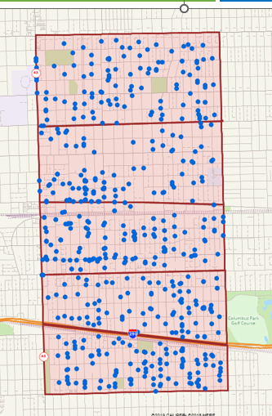
Introduction
Regional Distribution of Respondents*
North
(19%)
N-Central
(20%)
Central
(27%)
S-Central
(17%)
South
(17%)
*Weighted to 2020 Census data

Slide 6
Executive Summary

Slide 7
Executive Summary
The PDOP maintains very favorable esteem and value ratings from residents since 2019.
The District’s average esteem rating (measuring overall opinion on a 0-10 scale) is 8.0, virtually identical to its 8.2 average score in 2019 (no statistically meaningful difference).
Overall, 91% have a favorable opinion of the District (scores or 6 or higher), including 39% who hold the PDOP in highest regard (scores of 9 and 10).
    There is a slight downward shift from these “highest regard” scores (51% in 2019), to more “very” and “somewhat” favorable ratings (scores of 6-8) in 2023.
    However, the percent who have negative opinions have likewise dropped (from 4% in 2019 to 2% currently). In fact, the PDOP’s ratio of favorable-to-unfavorable ratings is greater than 45:1 (very positive).
  The strong scores are consistent across all regions and subgroups, with Oak Park residents of 25+ years giving the lowest scores (7.7 average – still very favorable).
    The PDOP’s ratings are significantly higher than 2022 benchmarks statewide (6.8 average) and from nearby suburban park agencies (5.9)*.
  On average, respondents estimate that 9.5% of their property taxes go to the PDOP, more than double the District’s actual 4.6% share.
    When informed that the District receives this 4.6% of one’s property taxes and asked to rate its value given the programs, parks, facilities and services provided, residents give a very strong 8.0 average value rating (on a 0-10 scale).
      This is the same average score reported in the 2019 survey, and far exceeds benchmark ratings statewide (5.9) and from neighboring suburbs* (5.1).
      Even those giving lower than average scores (men, residents in the South region) still give strong value ratings (averaging 7.3 or higher).
<pg. 18>
<pg. 19>
<pp. 28-30 >
* 2022 benchmark comparisons with neighboring agencies include Berwyn, Cicero, Elmwood Park, Forest Park, Maywood, Melrose Park, North Riverside, River Forest, River Grove, and Riverside.

Slide 8
Executive Summary
Respondents cite the quality/variety of programs, and the number/condition of local parks and playgrounds as top PDOP strengths.
When asked (in an open-ended format) to identify the District’s strengths or what they like most about the PDOP, the top response include:
  The programs, activities, and/or events that the District offers (cited by nearly half – 48%). Most often these responses include
    The range of activities offered across all age groups (tied as the #1 strength at 24% of respondents)
    The quality of these programs in general, especially sports and fitness
    Strong youth programming/options, as well as summer camps in particular
    Good variety of community events.
  Just over one in three (35%) also cite the District parks and playgrounds as a top strength, especially:
    The high level of maintenance and upkeep of the parks (also #1 at 24%)
    The overall quality of parks and open space
    The number and variety of local parks
    Quality playgrounds and play equipment.
  PDOP facilities and buildings rank a distant third (cited by 18% of respondents), most often:
    The outdoor pools
    The new Community Rec Center (CRC)
    Good facilities in general.
    Nearly as many (14%) include the District administration, management, and/or staff as a top strength, usually the level of communication and outreach (6%).
    About one in ten most value the location and proximity/accessibility of PDOP locations (11%), and half as many cite the affordable costs/fees (5%).
<pp. 20- 23>

Slide 9
Executive Summary
There is less consensus when respondents are asked about dislikes or needed improvements from the PDOP.
Over a third (36%) were unable to offer any suggestions or weaknesses for the PDOP, including 15% who said there is nothing they dislike at all. Among the remaining respondents:
  One in four offered suggestions for improved District administration/ management/staff (23%), usually concerning difficulties and stress when registering for programs (e.g., issues with the online platform/process, frustration when options fill up quickly). A few others also mention:
    A need for more/better outreach and communication from the District (updates, initiatives, plans, etc.)
    Perceptions of unnecessary spending (e.g., fast/hasty replacements of new improvements at specific parks)
    Concerns about the quality or engagement with program instructors, coaches, District staff, etc.
  Nearly as many (21%) offer suggestions for facilities, most often:
    More or improved sports facilities (sports fields, courts, etc.)
    Longer seasons or hours for specific facilities (usually the pools)
    A need/desire for an indoor pool to provide year-round swimming (3%).
  Park suggestions come from 12% overall (mostly concerns about safety), followed by program complaints (11%, usually requests for more adult options, both for seniors and/or adults without children).
  The top responses are rounded out by comments regarding PDOP’s costs and fees (again, usually for the pools or specific programs/events), mentioned by about one in ten.
<pp. 24- 27>

Slide 10
Executive Summary
Among the PDOP’s six core values, residents feel that Community Engagement, Inclusivity, and Integrity are most important.
A majority (52%+) rank each of these among the top three core values for the District:
  Community Engagement (57% top three), especially important to Hispanic/Latino residents and current/recent PDOP program participants. This was the #1 most important value to nearly a quarter of residents.
  Integrity (53%), especially important to middle-aged residents (45 to 54).
  Inclusivity (52%), especially for residents of color, relatively newer Oak Park residents, and non-participants in PDOP programs.
The remaining three are still deemed important to about a third of residents:
  Responsible Leadership (38%) ranks higher among residents ages 45-54, along with African Americans and recent PDOP program participants.
  Sustainability (38%), especially among younger adults ages 35 to 44 (regardless of race/ethnicity).
  Innovation (30%) ranked lowest overall but tends to be included more often among Asian adults and those with children ages 5 and under.
The PDOP’s performance on each core value is rated very strong, especially on the “top tier” options in terms of importance (Community Engagement, Inclusivity, and Integrity).
<pp. 32- 34>
<pp. 35- 36>

Slide 11
Executive Summary
Virtually all residents report visiting a PDOP park or facility in the past year and are very satisfied with those experiences.
Overall, 98% report that someone in their household as been to a District location in the past 12 months (up from 92% in the 2019 survey).
Nearly two-thirds (65%) report visiting Scoville Park during that time, and about half have been to:
About a third have been to:
Most often, residents use these locations for personal health and fitness, and/or because of their convenience and proximity to where they life. Others appreciate the availability of open space and natural settings, as well as safe places for children.
Satisfaction scores (on a 0-10 scale) remain very strong across District parks and facilities (despite being slightly lower vs. 2019 ratings). The highest scores go to:
  The overall experience, cleanliness/upkeep, and safety at these locations (8.3 average for each)
  Accessibility (8.2 average)
  Service provided by PDOP staff (7.9)
No group is dissatisfied with any attribute; all average scores of 7.3 or higher. The
top complaints are scattered, most often focusing on a lack of parking across various facilities, limited bathroom access (often locked/unavailable), homeless people in specific parks, suggestions for friendlier service from staff, and general upkeep.
<pp. 38- 40, 42-44>
  Austin Gardens (47%)
  Oak Park Conservatory (47%)
  Rehm Park (44%)
  Taylor Park (40%)
  Barrie Center/Park (33%)
  Mills Park (32%)
  Ridgeland Common Rec Complex (31%) and/or pool (29%)
  Rehm Pool (31%)
  Lindberg Park (30%)
  Longfellow Center/Park (29%)
<pg. 41>
<pp. 45- 48>

Slide 12
Executive Summary
Consistent with the 2019 survey, non-usage is usually due to not having young children.
In other words, non-visitors continue to perceive the PDOP as more focused on children and young families.
  This reflects some of the open-ended feedback cited earlier as well.
<pg. 49>
About a third (32%) have been inside the new CRC, and those familiar with the facility are very satisfied across the board.
This 32% includes self-reported members (13%) and recent non-member users (8%) who tend to live closest to the CRC (South and S-Central regions). The remaining 11% have toured but not used the facility and tend between ages 55-64.
Another 38% have seen the new facility but not yet been inside, and 19% have heard about the CRC but not driven past it. The remaining 11% remain unaware (especially those under age 35, renters, Asian residents, and the North region).
Those familiar enough with the CRC to offer an opinion give high satisfaction scores (averaging 7.1 on a 0-10 scale), especially self-reported members (8.3) and non-member users (7.7). Those who have only seen or heard about the CRC tend to give more neutral ratings (no strong opinions yet).
  The few who are less satisfied mostly cite the lack of an indoor pool, small workout space at the CRC, and/or the fees.
Still, at least 90% of those aware of the CRC agree that it:
  Is welcoming of everyone (97%)
  Makes Oak Park more attractive (95%) and helps property values (93%)
  Represents a good value (92%)
  Is inclusive and serves the diversity of Oak Park (92%) and meets the community’s needs (90%) – though residents in the South region and residents aged 45-54 are less likely to agree with these statements.
Nearly as many (87%) feel the CRC’s programs and activities are innovative (with slightly less agreement – 78% – among self-reported members). Residents in the South and those aged 45-54 are less likely to feel that the CRC meets their recreation/fitness needs (roughly 60% agree, vs. 79% overall).
<pg. 51>
<pg. 52>
<pp. 53-56>

Slide 13
Executive Summary
Respondents express a willingness to pay a property tax increase for an indoor pool facility.
Survey respondents were informed that building an indoor pool (including open swim, 25-yard lap lanes, and a separate warm water therapy pool) would require passage of a referendum which would increase annual property taxes by $90 per year for a median-valued home of $400,000.
Based on this description, residents express support by just over a 2:1 margin (69% vs. 31% opposed).
  Overall, 35% are “strong” supporters, vs. 14% who are “strongly” opposed.
  Support is especially strong among younger adults (under 35), renters, women, newer Oak Park residents, and those in the Central region.
  Older residents (ages 65+), men, and households in the South region tend to be more divided with smaller margins of support (roughly 53% to 56% in favor vs. 44% to 47% opposed).
Supporters give several reasons for their support, most often:
  A desire for year-round swimming (28%) or general need/interest (18%)
  The tax increase is reasonable (15%)
  Conditional support depending on facility hours, availability of adult/lap swimming, etc. (12%)
  Health and fitness benefits (11%)
  Overall asset and improvement for Oak Park (10%).
Among opponents, their top reasons driving their opposition are:
  Perceived lack of need in general (30%)
  Opposition to further increasing taxes that are already deemed high (25%)
  Existing indoor pool options which are available (16%)
  The OPRF High School is pursuing an indoor pool at the same time (10%).
<pp. 58-59>
<pp. 60-62>
<pp. 63-65>

Slide 14
Executive Summary
Awareness of the PDOPs scholarships and CDM discounts remains relatively low.
Overall, about one in five are either “very” (6%) or “somewhat” familiar (15%) with the District’s scholarship pool which provides financial assistance available to lower-income households.
  The good news is that those most likely to qualify (reporting household incomes under $50K) tend to be the most aware of this opportunity (23% “very” familiar, vs. 6% overall). Still, just over half of these lower income residents (51%) have never heard of these scholarships.
Similarly, only 12% are “very” (2%) or “somewhat” familiar (10%) with the District’s CDM offering for lower income residents with children in Kindergarten through age 14. Three in four overall (75%) have never heard of this program.
  Residents with children ages 12 to 14 tend to be more aware (12% “very” familiar, vs. 2% overall) – possibly because they have taken advantage of CDM in the past or currently. However, 59% of these households remain not at all aware of this assistance.
<pg. 67>
<pg. 68>
Residents report recent participation in several PDOP programs and events, with very strong satisfaction overall.
Reinforcing the District’s programming as a top strength, most respondents report household participation during the past year in a variety of programs and events.
  Top programs focus on youth activities (sports, summer camp, skating, gymnastics) and adult options (fitness/wellness, sports, performing arts).
  The top events include summer concerts, Movies in the Park, and Fall Fest.
Satisfaction is very strong for each (average 8.3 for both on a 0-10 scale). The few dissatisfied scores are attributed mostly to program instructors/leaders/coaches, etc., and/or registration challenges.
Ideas for programming opportunities tend to center around more for adults, especially fitness/yoga offerings, arts and crafts, and social events (e.g., get-togethers, game nights, music/entertainment options).
<pg. 71- 74>
<pg. 75- 76>

Slide 15
Executive Summary
As in 2019, residents mostly rely on the Village’s FYI Newsletter and the PDOP printed program guide when seeking Park District information.
Three in five (60%) cite both the printed program guide and the Village FYI newsletter as primary sources for PDOP information.
Another 46% now mention the District’s e-newsletter as a top source – significantly higher than the 2019 response (21%). The e-newsletter tends to be mentioned most often by younger adults (ages 35-44), households with children, and Asian and African American residents.
Nearly as many go to the PDOP website when seeking information (41%), and roughly a third cite flyers at District locations along with fence banners at these sites.
  The website is mentioned most often by adults under age 55, along with Hispanic/Latino adults. Nearly half of website users visit the site at least once a month (48%), while the rest mostly access it once every six months (35%).
  Flyers and fence banners tend to be mentioned by the youngest adults (under 35), renters and newer Oak Park residents, and the South region.
While 60% report using the printed program guide, fewer than half as many (27%) refer to the digital version on the PDOP website. Younger residents tend to prefer the digital version (under age 55), while those favoring the printed version tend to be slightly older (ages 45 to 64).
  In a separate question, most (59%) prefer continuing to receive the printed mailed version of the program guide. Both the youngest (under 35) and oldest (65+) residents prefer the printed guide, along with women and lower-income households.
  Conversely, 41% would rather receive an emailed link to updated digital guides with the option of picking up a hard copy at a PDOP location (especially men, those aged 35-64, and households earning $200K+).
<pp. 78-81>
<pg. 84>
<pp. 78-80>
<pg. 85>

Slide 16
Executive Summary
Only one in three respondents offer final comments or suggestions.
This final survey feedback is very scattered, with most suggestions centered on:
  Management/Administrative requests (13%) – most often extending the hours or seasons at specifical locations (usually the pools), more parking, increased safety/staff presence, better communication, reduced spending, and/or easier program registration (2% to 3% each).
  Park and facility issues (12%) – usually suggestions for amenities (e.g., benches, fitness stations, improved play equipment), better landscaping, more natural areas and sustainable practices, and more dog parks or off-leash areas.
  Programs and activities (7%), usually more options for adults along with a wider range of age groups (1% to 2% each).
<pp. 87-89>

Slide 17
I. Overall Opinions, Strengths/Improvements Sought, and Perceived Value of PDOP

Slide 18
Overall Esteem for Park District of Oak Park (PDOP)
Nine out of ten residents (91%) continue to have a favorable overall opinion about the Park District of Oak Park, based on esteem ratings using a 0-10 scale. Only 2% rate the District unfavorably, and the remaining 7% are neutral (no strong opinion either way).
Resident ratings are generally consistent with the 2019 survey results, despite a shift from “extremely favorable” scores (9+ on a 0-10 scale) to “very favorable” and “somewhat favorable” ratings. As a result, the overall average rating has dropped slightly (from 8.2 in 2019 to 8.0 currently).
That said, these ratings are still overwhelmingly positive, and are significantly higher than statewide and regional benchmarks (see next page).
In addition, these favorable scores are generally consistent across all subgroups and regions. The biggest differences (not statistically significant) are:
  Slightly higher scores in the North region (8.3) and among Asian households (8.8, n=31 cases)
  Slightly lower ratings from Oak Park residents of 25+ years (7.7 – still very favorable).
Ratio of Favorable : Unfavorable Scores
Overall Esteem for Park District of Oak Park (0-10 scale)
Avg. 0-10 Rating
8.0
45.5 : 1
8.2
22.5 : 1
Q2. Please rate your overall opinion of the Park District of Oak Park on a scale from 0 (completely dislike) through 10 (hold it in the highest regard), with 5 a neutral score. If you are unfamiliar with the District, please select “Unfamiliar”.

Slide 19
Overall Esteem for Park District of Oak Park (PDOP)
As reported, the PDOP’s esteem ratings outperform statewide and local agency benchmarks from 2022. This general pattern is consistent with the 2019 survey findings (when the PDOP’s average esteem rating was also a full point higher than the statewide average).
Benchmark Comparisons: Overall Esteem Ratings
Avg. (mean) Rating:
8.0
6.8
5.9
91%
Favorable
52%
68%
Q2. Please rate your overall opinion of the Park District of Oak Park. (0=completely dislike, 5=neutral, 10=highest regard).
* 2022 benchmark comparisons with neighboring agencies include Berwyn, Cicero, Elmwood Park, Forest Park, Maywood, Melrose Park, North Riverside, River Forest, River Grove, and Riverside.

Slide 20
PDOP Strengths
When asked in an open-ended format what they like most about the PDOP, most residents cite the programs and events (mentioned by 48%, usually the variety and quality of options, especially sports/fitness activities).
Over a third (35% total) cite something about the parks and open spaces, usually their level of maintenance/cleanliness, overall quality, and the number of local parks.
A number of other strengths are cited (e.g., facilities, management and staff), only less often.
Most Frequent Responses
What do you like most/
strengths about the PDOP
(top multiple open-ended responses, n=558)
PROGRAMS/ACTIVITIES/ EVENTS = 48% Total
PARKS = 35% Total
BUILDINGS/ FACILITIES = 18% Total
MANAGEMENT = 14% Total
LOCATION/ ACCESSIBILITY = 11% Total
GENERAL(Non- specific) = 7% Total
COST/FEES = 5% Total
Q3. Please describe what you like most about the Park District of Oak Park, or what it does particularly well.
NOTE: values <3% are not shown.

Slide 21
PDOP Strengths
Sample Verbatims: PDOP Likes/Strengths
Programs/Activities/Events (TOTAL NET = 48%)
“Multitude of programs for seniors, adults, children. Individual events and facilities are also great.”
“Variety of classes. The crafting for adults. Family cooking classes, teen cooking camps!”
“I think the Park District clearly puts a lot of effort into our various park programs. I love that we have such a diversity of programs offered, that there are special events, classes for both adults and children.”
“Wide variety of activities offered, well funded programs and knowledgeable staff.”
“We like the extensive offered programs and their overall quality. We especially like the gymnastics and ice skating ones that are really good. We like also the different events that are organized by the PDOP (like) Fall Fest, etc.”
“Amazing array of camps and services!”
“The offerings are excellent and plentiful for all ages of residents.”
“The park district continues to provide a variety of programming for different members of our community. They adjust programming to keep it relevant and are receptive to community feedback. I love the focus on building community in everything they do. We LOVE the park district.”
“Wonderful diversity of programs supporting residents of all ages for very affordable prices.”
“I appreciate the wide range of activities for multiple age groups.”
“Making very good use of our limited space and resources to offer high quality recreational programs.”
“The new role where someone is planning interesting things to do and activities for adults.”
Parks/Playgrounds/Trails (TOTAL NET=35%)
“Our village has diverse, numerous parks that are well-maintained and provide sufficient opportunities to sit and rest. Even those parks with few trees or grassy areas have a touch of nature, e.g., wildflowers that attract pollinators.”
“I visit Taylor Park frequently and it is so close to home and is kept up so well. The grass is mowed, and I like the walking path.”
“Very well-maintained parks, beautiful landscaping and ground, clean parks. Lots of parks throughout town; can always walk to a park.”
“Number and quality of parks, so many within walking distance. Very well maintained.”
“Clean, safe, properly maintained, beautifully curated and decorated.”
“Allows green space in areas of Oak Park and does a fair job of maintaining that space.”
“Accessible, they have up kept the parks. They are mostly clean; things seem to be repaired in a timely manner.”
“Beauty of the parks -- the field houses & playgrounds.”
“I like the parks - both play spaces and green spaces.”

Slide 22
PDOP Strengths
Sample Verbatims: PDOP Likes/Strengths (cont’d)
Buildings/Facilities (TOTAL NET=18%)
“The new CRC and the walking track.”
“Conservatory is wonderful and has a great Storytime.”
“I love the CRC and that they provided badminton time in their gyms. Pickleball and tennis are everywhere.”
“Both pool facilities The maintenance of all the parks, and tennis courts The collaboration with the high school for field space The CRC.”
“It has something for everyone. The parking, pools, tennis courts, children's playgrounds, etc.”
“Pools and CRC are great.”
“Tennis courts, Cheney Mansion, parks, Oak Park Conservatory.”
“Clean facilities and well maintained.”
“Good quality facilities and special recognition of effort to maintain ice on outdoor rinks despite poor weather.”
“Clean facilities and well maintained.”
“I like that you can rent the centers for parties.”
“'Uncorked' garden parties at the Conservatory; opportunity to rent beautiful venues like Cheney Mansion (as needed).”
PDOP Managements/Staff/Admin (TOTAL NET=14%)
“Communication, good facilities, priced to allow access by all.”
“Communication and mail pieces are good.”
“The coaches are amazing.”
“Great variety of programs run by competent people. Never bored!”
“They work hard to provide resources to the residents, even with limited green space.”
“Park District of Oak Park does a good job communicating activities and events in a timely manner via electronic media (e-mail, social media, print etc.).”
“I have enjoyed the fantastic day trips to new places. The staff is always nice and helpful.”
“They listen to the community and bring new activities…providing plenty options for leisure and fun.”
“Activities for all ages -- family oriented -- most are reasonably priced -- organized catalogue.”
“Diversity and thoughtfulness of staff. Nature and arts programming.”
“Great caliber of instructors for fitness classes.”
“Staff at clubhouse and how engaged they are with kids.”
Location/Accessibility (TOTAL NET=11%)
“I like that there are parks scattered throughout the Village.”
“There are a few parks spread across the village that I have access to. Each one has its own unique feature to it, adding to the variety of each park.”
“The many parks, large and small.”
“The variety of the parks. It’s great and the fact there are so many. I've visited many on my bicycle.”
“Location. Most within walking distance of my residence.”
“I can walk to Scoville Park.”
“The parks are easily accessible and kept clean, open to all residents. Even parents from beyond Oak Park's borders can bring their children to play.”

Slide 23
PDOP Strengths
Sample Verbatims: PDOP Likes/Strengths (cont’d)
General non-specific comments (TOTAL NET=7%)
“Overall, I think we have an excellent park district.”
“Well maintained and serviced.”
“Options and interests.”
“I like that the Oak Park Park District exists and strives to cater to the needs and interests of Oak Parkers.”
“Great variety for all ages.”
“PDOP offers a variety of services and offerings.”
Cost/Fees (TOTAL NET=5%)
“The diversity of programs, the affordability of programs.”
“Quality programs for residents of all ages at an affordable price.”
“I really like that residents can use the indoor track for free.”
“The amount of any given park available and free toddler programs.”
“Offers a lot of programs and childcare options at an affordable price.”

Slide 24
PDOP Dislikes/Improvements Sought
Respondents had a more difficult time identifying something they dislike or would like to see improved by the PDOP. Over a third (36%) could not think of anything (including 15% who said there is nothing they dislike).
The specific dislikes were very scattered, with the program registration process/website cited most often by 8% overall (usually because programs fill too quickly, or the platform is cumbersome). Almost as many (7%) feel that program and membership fees are too high. The remaining responses are mentioned by fewer than 5% each.
The feedback on PDOP facilities is varied (e.g., general improvements, longer pool hours/season, larger fitness area at CRC, lack of an indoor pool).
Most park-related comments concern safety, or more amenities (bathroom access, benches, lighting). Many program suggestions focus on more adult options and scheduling outside of work hours (more evening, weekend programs).
Most Frequent Responses
What do you dislike/want improved by the PDOP
(top multiple open-ended responses, n=558)
MANAGEMENT = 23% Total
BUILDINGS/ FACILITIES = 21% Total
PARKS = 12% Total
PROGRAMS/ACTIVITIES/ EVENTS = 11% Total
COST/FEES = 9% Total
Q4. What do you dislike about the Park District of Oak Park, or what could it do better?
NOTE: values <3% are not shown.

Slide 25
PDOP Dislikes/Improvements Sought
Sample Verbatims: PDOP Dislikes/Improvements Sought
PDOP Managements/Staff/Admin (TOTAL NET=23%)
“Enrollment feels very competitive, we don't always get into the classes we put on our wish list.”
“The registration process for anything children-related is extremely frustrating and the spots are very limited.”
“Registration is very stressful. Doesn't seem like enough spots available for events and programs.”
“Mad scramble to get one of the few spots for certain sports. Registering for classes are very difficult for older (me) individuals who are not familiar with online registration. Would rather call a telephone number & talk to a real person!”
“I really dislike the Amilia registration system as the replacement for the previous Mind Body system. The Amilia system was very frustrating when it was first rolled out. It is still confusing to me when I register for a drop-in Nia class using my 10 pack of classes. The website is very hard to navigate.”
“Please improve the online signup system for summer camps. The system has crashed in the past due to interest/demand.”
“Sign up process and competitiveness of it.”
“Registration can be tough. System times out when trying to get summer camps and you get shut out of programs.”
“Prefer more advertising of events.”
“Lack of communication around programs and coordinators of programs. Lack of response to email and voice mails. Lack of communication with the public – e.g., their handling of the floors at Pleasant Home was atrocious.”
“Not enough communication with lap swimmers, the most dedicated and enthusiastic users of the pool. One result was a bad redesign of the Ridgeland women's locker room, replacing a simple central spot to sit while changing with an insufficient number of private changing cubbies.”
“It could do a better job of outreach to ALL Oak Parkers.”
“I was disappointed about the way communication was shared signing up for gymnastics in the fall. We are new to Oak Park and enrolled for one week of summer gymnastics camp. When it came for fall registration, we did not know that that one week counted as having been enrolled in gymnastics 'summer camp' and that we were eligible for early fall enrollment. There was no email explaining that the one week we had participated in counted. As a result, we enrolled with the rest of OP and of course didn't get into any of the fall programming. My kids were heartbroken. I was really disappointed that no email was shared explaining that we would have qualified to enroll early.
“Sometimes it feels like maintenance and/or improvements aren't planned out well. They build then sometimes remove or replace it a few years later.”
“I think the Park District is too quick to replace park equipment rather than doing the more fiscally responsible thing of repairing and refurbishing.”
“In my opinion, many construction projects, improvements and maintenance efforts appear wasteful and much of it unnecessary.”
“Spends too much money, we keep building new buildings, updating parks with state of art equipment that is not needed.”
“Stop re-doing parks when play equipment is just fine! If stuff is good enough to donate, it's good enough to keep.”
“Ticket people who litter.”
“Please enforce people to pickup after their dog.”
“Sometimes dogs are not on a leash.”
“I wish the lifeguards at the community pools did a better job of enforcing pool rules, specifically enforcing proper use of lap lanes.”
“Class quality is very dependent on instructors and some of them aren't great. I would say my satisfaction with classes has been 50%. I just don't feel confident when signing up that I will be satisfied with any given class.”
“My nine-year-old took a week-long class during the summer and the program and counselors weren't that good.”
“Administrative staff falls down on the job sometimes. Team sport prices too high.”
“Staffing - serious staffing issues. I understand how difficult staffing is these days, but it has always been an issue with the park district. Pay more! Devote more resources to your employees.”

Slide 26
PDOP Dislikes/Improvements Sought
Sample Verbatims: PDOP Dislikes/Improvements Sought
Buildings/Facilities (TOTAL NET=21%)
“Some of the tennis courts are in bad shape. The pickle ball courts could be repaved. More dedicated pickle ball courts.”
“Lack of outdoor basketball courts.”
“They did not provide the proper court lines for badminton. We are making do with pickleball court lines. I encourage them to look at Wheeling Park District's CRC and how they allot time in their gyms for sports including badminton. They must make about $200 on a Monday night $5 drop-in badminton utilizing 6 courts. Utilizing a system like that would encourage more players to use the gyms and bring in revenue for the CRC.”
“Projects done without expert input, e.g., Barrie pickleball courts.”
“Should have more basketball hoops. Couldn't tennis courts do double duty?”
“I'm disappointed that the newly developed CRC did not take into consideration that there is not enough large classroom space for the fitness classes, such as Nia. What a disappointment that such a beautiful new facility can't be used and thus those classes will still be shunted to too-small spaces in older buildings.”
“CRC is a very nice facility but…the space allocated to the workout area, where most users go, is unbelievably small! Why have a huge skating rink and small rooms for other programs?”
“Lack of bathroom access at many of the parks.”
“Bathrooms are often locked in fall, winter, spring with no porta potty options. This is hard with young kids needing to use the bathroom.”
“The only issue I have with the park district is the pool schedule during the summers. It seems ridiculous for the pools to close as early as they do, and have limited schedules during certain times of the year. The memberships are not cheap and to limit how late they stay open really impacts how much we are able to utilize the pool pass outside of weekends. It would be great to be able to have the pools open until 8 or 9 PM so that families could take kids after work and dinner.”
“I'd like to see longer hours at the pools, and better functionality for booking fields and understanding when fields are open and when they're reserved or in use. Also, we have friends and family members with mobility challenges, I think many of the facilities need to be more accessible, specifically parking.”
“Oak Park needs an indoor pool that offer swim lessons and activities for youth and adults alike. The only other reasonable option is the YMCA. I however, have to drive all the way to Triton college for classes.”
“Needs an indoor pool for lap swimming.”
“In a community of this size with the taxes that are paid, that there is not a year-round aquatic facility for pool activities, programs, and free swim for residents is a disgrace.”
“Indoor pool please! Also, we are not nearly where surrounding communities are on the number of available and dedicated pickleball courts. No dog parks in northeast Oak Park.”

Slide 27
PDOP Dislikes/Improvements Sought
Sample Verbatims: PDOP Dislikes/Improvements Sought (cont’d)
Parks/Playgrounds/Trails (TOTAL NET=12%)
“I live near Maple Park. Need to secure it; there's no reason to have a west gate that's right off Harlem which is a busy street. That gate should be locked or removed. We need to be safe: What if a child runs into Harlem Avenue, or (it’s an) easy exit if someone abducts a child.”
“The parks are not regularly monitored after dark. There are frequent gatherings of loud teenagers. We tried talking with them but it was unsuccessful.”
“Have some police presence at certain parks. The ones on Lake street closer to Austin.”
“Lighting could be better in smaller parks.”
“Homeless people who sleep there. They should have someplace else to go.”
“Could use bathrooms on the premises. I miss the old sledding hill. Would like more walking paths and intermittent exercise apparatus for seniors.”
“Bathrooms in the parks would be great, especially when the park hosts sports.”
“Litter seems to be an issue in some parks. However, I understand there's limited resources for frequent trash sweeps.”
“I dislike the lack of upkeep at the south end of town. I live a block from Barrie Park and the basketball and pickleball courts are in terrible shape. The green and grassy area surrounding it is always overgrown, you can barely walk on the narrow sidewalk, and it's unsafe with traffic passing so close by.”
Programs/Activities/Events (TOTAL NET=11%)
“If the adult programming could be made more available on evenings and weekends, that would make it more accessible to those of us who work 9 to 5.”
“More events for single adults.”
“Offer more evening adult classes for those who of us who are not yet retired.”
“It needs more 'maker' classes for active adults, like 3-D printing, laser cutting/etching, etc. It seems that (current) maker classes are oriented to kids.”
“I wish there were more sports camps during the summer and throughout the year. Chicago Edge runs very good ones, but those run by the park district tend to be very basic, and seem like they're run by random high schoolers, not people more engaged in the sport and education of kids.”
“Used to have overnight travel like to Starved Rock; need to start offering again. Need to offer in-person Tai Chi; why did this stop?”
“More senior programming.”
Cost/Fees (TOTAL NET=9%)
“It charges too much for certain programs. The prices for pool general admission and pool passes are outrageously high, even for residents. The Park District of Oak Park absolutely should look into finding ways to bring down the costs for residents, because there are other communities that structure their pool admission prices that way.”
“As a parent of young children, I was surprised at having to pay for activities for children under two or for parents for activities like the Santa Trolley.”
“For residents, outside of a season pool pass, the cost is prohibitive.”
“Swimming pool access is expensive if you only go occasionally.”
“The classes are overpriced for what the level of instruction given. My child has not walked away from a class saying, 'I really improved.’”
“Administrative fee is charged when you request a refund for an event.”
“Some of the programs are expensive. Though worth it, we can't afford to do extra in Oak Park.”
“Sometimes prices are too high for residents, like the cost of a single entry to the pool.”

Slide 28
PDOP’s Estimated Share of Property Taxes
On average, residents estimate the PDOP’s share of local property taxes to be double the actual percentage (average estimate of 9.5% share, vs. actual 4.6% share of property tax revenues).
This average is up very slightly from 2019 estimates (8.1% overage), mostly due to fewer giving estimates under 4%.
Nearly one in five adults (17%) gave estimates of over ten percent going to the District (similar to 19% in 2019). The highest estimates tend to come from:
  Residents in the North-Central region (13.8% average estimate, vs. 9.5% overall)
  Homeowners (10.6% average estimate)
  African American adults (15.4% average estimate).
Those giving lower than average estimates (but still well above the District’s actual 4.6% share of property taxes) include:
  Residents in the South region (8.0% average estimate)
  Renters (7.6% average estimate)
  Asian and white adults (6.3% and 7.5% average estimates, respectively).
Estimated PDOP Share of Property Taxes
Avg. = 9.5%
Avg. = 8.1%
Correct: 4.6% share of property taxes
Q5. About what percent of your property taxes do you think goes to the Park District of Oak Park? Please provide your estimate without checking your tax bill or any other information – we’re simply interested in your best estimate.

Slide 29
Value of PDOP’s Share of Property Taxes
When informed that the PDOP represents 4.6% of one’s property taxes, residents continue to rate it a “great” value overall (average 0-10 score of 8.0, identical to 2019 results).
As in 2019, at least four out of five residents (82%) rate the District at least a “good” value, including just over half (51%) rating it an “excellent” value (scores of 9+ on the 0-10 value scale).
By comparison, only 5% rate the District a poor value, and the remaining 13% feel it is an “average” value overall.
Furthermore, all subgroups feel the PDOP represents a good-to-great value overall. No segment gives average value ratings below a 7.3 (on the 0-10 scale).
Significant Differences: PDOP’s Perceived Value Relative to District’s Share of Property Taxes
Most Value
Least Value
Higher than Avg. Ratings:
S-Central (8.3) and North regions (8.3)
HH income <$50K (8.7)
Women (8.2)
OVERALL AVERAGE = 8.0
Lower than Avg. Ratings:
Men (7.7)
Refused to reveal HH income (7.5)
South region (7.3)
Q24. About 4.6% of your property taxes goes to the Park District of Oak Park. Thinking about the programs, parks, facilities, and services that the Park District provides, please rate the overall value that it represents given its share of property taxes. (0=poor value, 5=average value, 10=excellent value)

Slide 30
Value of PDOP’s Share of Property Taxes
The PDOP’s strong value ratings far surpass the statewide and local suburban benchmarks for park agencies – especially the percentage who rate the PDOP an “excellent” overall value.
Benchmark Comparisons: Overall Value Ratings
Avg. (mean) Value Rating:
8.0
5.9
5.1
82%
Positive
value
53%
45%
Q24. About 4.6% of your property taxes goes to the Park District of Oak Park. Thinking about the programs, parks, facilities, and services that the Park District provides, please rate the overall value that it represents given its share of property taxes. (0=poor value, 5=average value, 10=excellent value)
* 2022 benchmark comparisons with neighboring agencies include Berwyn, Cicero, Elmwood Park, Forest Park, Maywood, Melrose Park, North Riverside, River Forest, River Grove, and Riverside. The 2022 benchmark survey tested value ratings at a 5% share of property taxes.

Slide 31
II. Assessment of PDOP’s Six Core Values

Slide 32
Six core values for the PDOP were shown to respondents, who were asked to rank them in order of importance (with #1 being the top priority). The top three core values clearly include “community engagement” followed closely by “inclusivity” and “integrity”.
PDOP Core Values
Note that while “inclusivity” and “integrity” receive virtually identical “top three” responses, the former is deemed more important based on a clear advantage of “#1” rankings.
The three remaining core values receive fewer #1 and “top three” scores, with at least three in ten residents including them among the Top 3 most important. The remaining 10% choose not to provide a ranking.
Perceived Importance: PDOP Core Values
Q25. Below are the Park District of Oak Park’s core values. Please read each and then rank them by importance to you.

Slide 33
Among the three “top tier” core values, the most recent residents and Hispanic/Latino adults tend to include both “community engagement” and “inclusivity” among their top priorities. Those placing the highest priority on “integrity” tend to be slightly older.
PDOP Core Values
Note that “community engagement” tends to be most important (ranked #1) among the lowest income households, but the most affluent residents (incomes of $200K+) disproportionately include it among their “top three” (meaning it tends to rank as their #2 or #3 priority).
Significant Differences: Top Tier PDOP Core Values
 | #1 Most Important | Top 3 Most Important
Community Engagement | 24% Overall Hispanic/Latino adults (38%, n=46), and white adults (28%) HH income <$50K (37%) PDOP program participants (30%, vs. 14% of non-participants) | 57% Overall Hispanic/Latino adults (86%, n=46) Lived in Oak Park <5 yrs. (63%) HH income $200K+ (65%) PDOP program participants (65%, vs. 46% of non-participants) CRC members (74%, vs. 56% of non-members)
Inclusivity | 21% Overall North region (36%) Hispanic/Latino adults (43%, n=46), Asian adults (40%), African Americans (31%) Lived in Oak Park 5-14 yrs. (34%) Non-PDOP program participants (28%, vs. 16% of participants) | 52% Overall Ages 35-44 (66%) Hispanic/Latino adults (73%, n=46) Lived in Oak Park <5 yrs. (60%), 5-14 yrs. (73%) Have children ages 6-11 (64%)
Integrity | 13% Overall South (25%) Ages 45+ (16%, vs. 5% of 35- to 44-year olds) Lived in Oak Park <5 yrs. (18%) | 53% Overall Ages 45-54 (67%) African American adults (59%), white adults (57%) Non-CRC members (56%, vs. 38% of members)

Slide 34
For the remaining core values, middle aged residents (45 to 54), African Americans and recent PDOP program participants tend to place higher priority on “responsible leadership”, while “sustainability” is especially important to younger adults across several races.
PDOP Core Values
Asian residents and CRC members tend to rank innovation as their #1 priority, and those with children aged 5 and under include it in their Top 3.
Significant Differences: Top Tier PDOP Core Values
 | #1 Most Important | Top 3 Most Important
Responsible Leadership | 13% Overall N-Central region (25%) Ages 45-54 (23%) African Americans (23%) Lived in Oak Park 5-14 yrs. (20%), 15-24 yrs. (28%) PDOP program participants (18%, vs. 11% of non-participants) | 38% Overall Men (46%, vs. 33% of women) Ages 45-54 (51%) African Americans (50%) HH income $50K-$99K (49%) PDOP program participants (48%, vs. 24% of non-participants)
Sustainability | 10% Overall Ages 35-44 (19%) White adults (13%) | 37% Overall Under age 35 (46%), 35-44 (53%) Asian adults (73%), Hispanic/Latino adults (42%) and white adults (42%) Lived in Oak Park <5 yrs. (49%)
Innovation | 9% Overall Asian adults (16%) Lived in Oak Park <5 yrs. (16%) CRC members (20%, vs. 7% of non-members) | 30% Overall Have children ages 5 and under (42%)
No answer/Can’t say | 10% Overall Ages 55-64 (16%), 65+ (22%) Lived in Oak Park 25+ yrs. (24%) | < no statistically meaningful differences >

Slide 35
When asked to assess the PDOP’s performance on these six core values, the District receives consistently strong scores with at least 64% giving positive scores (4s and 5s on a 1-5 scale). Note that it receives the most “excellent” ratings for “inclusivity”.
PDOP Core Values
None of these are considered weaknesses or concerns among residents, as no more than 7% overall rate the District poorly (scores of 1 or 2). The average 1-5 ratings are also all very strong (between 3.8 and 4.0)
The table on the next page shows that there are relatively few significant differences in these ratings, meaning all groups and regions feel the PDOP is strong in each area.
  In general, younger residents and lower-income households tend to be more favorable toward the District across most attributes. Slightly lower than average (still positive) scores are most likely to come from those earning over $100K, and ages 45-54 (especially on “responsible leadership” and “sustainability”).
  Note that Hispanic/Latino adults tend to give slightly lower ratings for “community engagement”, a core value that this segment feels is more important than average (an opportunity for the District to address).
Assessment of PDOP’s Performance on Core Values
(1-5 scale)
Top 2 Box (4s and 5s)
76%
73%
72%
70%
67%
64%
Avg. Rating (1-5 scale)
4.0
4.0
3.9
3.9
3.8
3.8
Ranked by Importance
Q26. Please rate how well the Park District is performing on each of those core values. (1-5 scale)

Slide 36
PDOP Core Values
Significant Differences: Assessment of PDOP’s Performance on Core Values (average 1-5 ratings)
 | Lower than Average | Higher than Average
Community Engagement (avg. = 4.0) | South region (3.7) Hispanic/Latino adults (3.7) HH income $100K-$199K (3.8) | N-Central (4.2) and Central regions (4.1) Under age 35 (4.2) Asian adults (4.4) HH income <$50K (4.3)
Inclusivity (avg. = 4.0) | Non-CRC members (4.0) | CRC members (4.2)
Integrity (avg. = 3.9) | Hispanic/Latino adults (3.6) HH income $100K-$199K (3.8) | Asian adults (4.3) HH income <$50K (4.3)
Sustainability (avg. = 3.9) | Ages 45-54 (3.6) HH income $100K-$199K (3.7) | Under age 35 (4.1) HH income <$50K (4.2)
Responsible Leadership (avg. = 3.8) | Ages 55-64 (3.6) | Under age 35 (4.2)
Innovation (avg. = 3.8) | HH income $100K+ (3.6) | HH income <$100K (4.1)

Slide 37
III. PDOP Park/Facility Usage and Satisfaction

Slide 38
PDOP Usage/Visits in Past Year
As in the 2019 survey, virtually all residents report visiting a PDOP park or facility in the past year (98%, up from 92% four years ago).
Among recent visitors, Scoville Park remains the top destination (cited by roughly two out of three respondents). Nearly half have also visited the Oak Park Conservatory, Austin Gardens, and Rehm Park.
At the time of this survey, one in four (25%) report visiting the new CRC which opened in mid-2023.
PDOP Parks (NET 94%)
Scoville Park | 65%
Austin Gardens | 47%
Rehm Park | 44%
Taylor Park | 40%
Barrie Center/Park | 33%
Mills Park | 32%
Lindberg Park | 30%
Longfellow Center/Park | 29%
Maple Park | 23%
Fox Center/Park | 19%
Field Center/Park | 19%
Euclid Square Park | 18%
Stevenson Center/Park | 18%
Andersen Center/Park | 12%
Carroll Center/Park | 11%
Randolph Park | 7%
Wenonah Park | 2%
Visited PDOP Park or Facility in Past 12 Months?
n=543
PDOP Facilities (NET 82%)
Oak Park Conservatory | 47%
Ridgeland Common Recreation Complex | 31%
Rehm Pool | 31%
Ridgeland Common Pool | 29%
Pleasant Home | 25%
Community Recreation Center | 24%
Elizabeth F Cheney Mansion | 22%
Gymnastics and Recreation Center | 17%
Dole Center | 15%
Paul Hruby Ice Arena | 12%
Austin Gardens Education Center | 8%
Q6. Which parks and facilities have you or other household members visited in the past 12 months?

Slide 39
PDOP Usage/Visits in Past Year
Looking at the top visited (self-reported) PDOP parks in the past year and where these visitors live, it becomes clear that most are heavily used by “neighbors”, with only a couple of sites attracting residents District-wide.
For example, Scoville Park and Austin Gardens draw disproportionately from the N-Central region (relative to the percent of the population in this area).
The same is true for Rehm Park which draws the largest numbers from the S-Central and South regions.
  While the N-Central area accounts for 20% of the overall population, only 12% of Rehm Park visitors come from that area.
This pattern of drawing large numbers from proximate neighborhoods is consistent across most of the top PDOP parks visited, with two exceptions. Both Stevenson Park/Center and Wenonah Park tend to draw more evenly from throughout the District (no statistically meaningful differences).
PDOP Parks | n | Region | Region
 |  | North | N Central | Central | S Central | South
Overall (row) % of Respondents | 558 | 19% | 20% | 27% | 17% | 16%
Scoville Park | 358 | 18% | 25% | 25% | 15% | 16%
Austin Gardens | 273 | 18% | 28% | 29% | 13% | 12%
Rehm Park | 257 | 16% | 12% | 18% | 26% | 27%
Taylor Park | 254 | 32% | 27% | 12% | 13% | 16%
Mills Park | 140 | 7% | 18% | 47% | 19% | 9%
Barrie Center/Park | 175 | 9% | 11% | 17% | 26% | 37%
Lindberg Park | 188 | 41% | 15% | 18% | 11% | 14%
Longfellow Center/Park | 162 | 9% | 19% | 16% | 35% | 21%
Maple Park | 147 | 10% | 8% | 15% | 26% | 41%
Fox Center/Park | 121 | 10% | 18% | 15% | 42% | 15%
Field Center/Park | 110 | 47% | 25% | 6% | 9% | 13%
Euclid Square Park | 118 | 11% | 7% | 20% | 29% | 33%
Stevenson Center/Park | 118 | 16% | 30% | 26% | 15% | 14%
Andersen Center/Park | 78 | 38% | 37% | 3% | 13% | 10%
Carroll Center/Park | 83 | 14% | 6% | 7% | 31% | 42%
Randolph Park | 41 | 3% | 9% | 68% | 8% | 13%
Wenonah Park | 18 | 10% | 17% | 26% | 27% | 20%
= statistically higher regional response
Q6. Which parks and facilities have you or other household members visited in the past 12 months?
NOTE: %s may not total to 100% due to rounding.

Slide 40
PDOP Usage/Visits in Past Year
Comparing the regional “draws” for PDOP facilities, this regional pattern is less evident as residents from throughout Oak Park tend to report recent visits to most facilities.
The few statistically significant regional differences indicate that:
  Ridgeland Pool tends to attract N-central residents
  Pleasant Home tends to draw visitors from the Central region
  Dole Center is visited most often by those in the North region.
PDOP Facilities | n | Region | Region
 |  | North | N Central | Central | S Central | South
Overall (row) % of Respondents | 558 | 19% | 20% | 27% | 17% | 16%
Oak Park Conservatory | 276 | 14% | 23% | 28% | 21% | 14%
Ridgeland Common Recreation Complex | 176 | 23% | 27% | 18% | 19% | 13%
Rehm Pool | 194 | 16% | 16% | 22% | 24% | 23%
Ridgeland Common Pool | 173 | 22% | 29% | 18% | 18% | 13%
Pleasant Home | 136 | 10% | 24% | 43% | 12% | 10%
Community Recreation Center | 151 | 21% | 13% | 20% | 26% | 20%
Elizabeth F Cheney Mansion | 159 | 13% | 29% | 25% | 23% | 10%
Gymnastics and Recreation Center | 108 | 26% | 21% | 17% | 18% | 18%
Dole Center | 116 | 33% | 22% | 13% | 22% | 11%
Paul Hruby Ice Arena | 75 | 23% | 12% | 25% | 16% | 24%
Austin Gardens Education Center | 45 | 12% | 20% | 47% | 7% | 13%
= statistically higher regional response
Q6. Which parks and facilities have you or other household members visited in the past 12 months?
NOTE: %s may not total to 100% due to rounding.

Slide 41
PDOP Usage/Visits in Past Year
Roughly one in ten respondents report that Scoville Park and Austin Gardens are their most visited PDOP locations (especially older residents and those in the N-Central region). Lindberg Park and Mills Park tend to attract younger adults most often.
Most Visited PDOP Parks/Playgrounds/Facilities Visited in Past Year
Especially: N-Central region (28%); ages 65+ (17%); African American adults (19%)
Especially: N-Central region (24%); ages 55+ (15%)
Especially: North region (30%); under age 35 (16%); Asian adults (27%)
Especially: North region (28%)
Especially: South region (35%), ages 45-54 (15%); households with children (19%) especially under age 5 (26%)
Especially: Central region (22%); Under age 35 (17%); women (11%, vs. 1% of men)
Especially: Ages 55-64 (13%);
Q7. From the list above, which three parks, playgrounds, facilities or shelters do you use most often?
NOTE: values <4% are not shown.

Slide 42
Reasons for Using PDOP Sites
The #1 reason for visiting a PDOP location is for personal health and fitness, with convenience and proximity a strong secondary reason. Those with children tend to cite safety as the top reason, while the broader population rank enjoying natural setting among their top reasons.
Most Visited PDOP Parks/Playgrounds/Facilities Visited in Past Year
= 49% Top 3
= 57%
= 21%
= 39%
= 26%
= 24%
= 16%
= 13%
= 10%
= 9%
= 6%
Q10. What are your top three reasons for using PDOP parks and facilities (rank ordered).
NOTE: Individual %s may not total Top 3 %s due to rounding. Values <3% are not shown.

Slide 43
Renters, and those without children tend to use District locations for their personal health and fitness, and out of convenience/proximity to where they live. The relatively few differences among those citing “convenience/proximity” indicate ample options and locations throughout Oak Park.
Reasons for Using PDOP Sites
As reported, those with children tend to use the PDOP for safe locations and activities. This is especially true for those in the North and South regions, along with men and higher-income households.
Significant Differences: Top Reasons for Using PDOP Parks/Facilities
 | #1 Reason | Top 3 Reasons
Personal fitness/health | 31% Overall N-Central (41%) Under age 35 (42%) Renters (41%, vs. 24% of homeowners) No children in household (38%, vs. 13% of those with children) | 49% Overall North (58%), N-Central (58%), and S-Central regions (57%) Under age 35 (60%), 55-64 (59%) Renters (59%, vs. 42% of homeowners) CRC members (73%, vs. 46% of non-members) No children in household (58%, vs. 27% of those with children)
Convenient, close to home | 17% Overall HH income <$50K (36%) No children in household (20%, vs. 10% of those with children) | 57% Overall Renters (65%, vs. 51% of homeowners) No children in household (61%, vs. 47% of those with children)
Somewhere safe to bring children | 16% Overall North (22%) and South regions (28%) Ages 35-44 (29%), 45-54 (23%) Homeowners (23%, vs. 5% of renters) Men (21%, vs. 12% of women) Lived in Oak Park <25 yrs. (20%) HH income $200K+ (27%) PDOP program participants (23%) Have children in household (40%), especially under age 5 (54%) | 21%Overall North (30%) and South regions (32%) Ages 35-44 (42%), 45-54 (28%) Homeowners (32%, vs. 5% of renters) Lived in Oak Park 5-14 yrs. (37%) HH income $100K-$199K (25%), $200K+ (37%) PDOP program participants (30%, vs. 9% of non-participants) Have children in HH (55%), especially under age 5 (77%)

Slide 44
Younger adults, the Central region, and those without children especially go for the relaxed/quiet settings of PDOP parks, while non-white residents (especially Hispanic/Latino adults) appreciate the value that the District represents (along with CRC members)
Reasons for Using PDOP Sites
The remaining top reasons had relatively few differences due to the smaller number of cases/responses.
Significant Differences: Top Reasons for Using PDOP Parks/Facilities (cont’d)
 | #1 Reason | Top 3 Reasons
Relaxation, quiet setting | 4% Overall Central region (10%) Under age 35 (8%) Non-CRC members (5%) No children in HH (5%, vs. 1% of those with children) | 24% Overall Central region (34%) Under age 35 (46%) Renters (33%, vs. 18% of homeowners) White residents (28%) HH income $50K-$99K (35%) Non-PDOP program participants (34%, vs. 17% of participants) Non-CRC members (27%, vs. 5% of members) No children in HH (30%, vs. 9% of those with children)
Community/ special event | 2% Overall < no statistically meaningful differences > | 16% Overall N-Central (22%) and Central regions (22%) Ages 55+ (21%) African American adults (26%) HH income <$50K (27%) PDOP program participants (16%, vs. 6% of non-participants)
Participate in program/class | 2% Overall < no statistically meaningful differences > | 13% Overall Ages 45-54 (18%) Women (17%, vs. 8% of men) Lived in Oak Park 5-14 yrs. (25%), 15-24 yrs. (18%) PDOP program participants (18%)
Affordable, good value | 2% Overall Ages 55-64 (7%) Non-whites (8%, vs. 1% of white adults) PDOP program participants (4%, vs. 1% of non-participants) | 10% Overall S-Central (15% and South regions (14%) Hispanic/Latino adults (28%) PDOP program participants (15%, vs. 4% of non-participants) CRC members (22%, vs. 8% of non-members)

Slide 45
Satisfaction with Recent PDOP Visits/Usage
PDOP park and facility users continue to be very satisfied with their overall experience at these locations, and with all attributes – especially overall cleanliness and safety. These scores remain very strong despite slight declines since the 2019 survey.
Consistently, 67% or more users remain satisfied with each attribute, including a majority (50%+) who are “completely satisfied” (scores of 9+ on a 0-10 scale).
  Note that fewer than one in ten users are dissatisfied with any of the attributes tested.
The average 0-10 ratings (7.9 or higher) are very strong as well. Comparing these averages by subgroups, no segment is dissatisfied. The lowest average score (7.3 from those in the South region on overall access) is still positive.
Satisfaction with PDOP Parks/Facilities Visited (0-10 scale)
Avg. 0-10
Rating
2019 Avg.
Ratings
8.3
8.6
8.3
8.5
8.3
8.7
8.2
8.5
7.9
8.3
Q8. Thinking about those parks and facilities you recently visited, please rate your overall satisfaction with the following.
NOTE: values <4% are not shown.

Slide 46
Satisfaction with Recent PDOP Visits/Usage
Consistently, higher scores tend to come from the North and Central regions, with Asian adults especially satisfied with overall accessibility and staff service.
Lower-income residents also tend to be more satisfied than average.
 | Lower than Avg. Ratings | Higher than Avg. Ratings
Overall experience (8.3) | < no statistically meaningful differences >
Overall cleanliness, maintenance, and upkeep (8.3) | - South region (7.7) - Ages 45-54 (8.0) - Men (8.0) - HH income $100K-$199K (7.9) | - Central region (8.7) - Ages 65+ (8.6) - Women (8.6) - HH income <$50K (9.4) - PDOP program participants (8.7, vs. 8.1 of non-participants)
Overall safety (8.3) | - South region (7.6) - HH income $100K-$199K (8.1) | - North (8.8) and Central (8.6) regions - HH income <$50K (9.1)
Overall access - parking, paths, entrances/exits (8.2) | - South region (7.3) - Hispanic adults(7.6) - HH income $50K+ (8.1) | - North (8.6), Central (8.5), and S-Central (8.4) regions - Asian adults (9.3) - HH income <$50K (9.2)
Level of service provided by park district staff (7.9) | - White adults (7.8) - HH income $100K+ (7.6) | - Asian adults (9.0) - HH income <$50K (9.0)

Slide 47
Reasons for Dissatisfaction: Parks/Facilities
Residents giving lower satisfaction scores (6 or below) cite a wide range of concerns, mostly centered around limited parking, presence of homeless people at the parks, suggestions for staff (friendlier service, more supervision), and cleanliness (e.g., litter, dog droppings).
Reasons for Dissatisfaction with PDOP Parks or Facilities (multiple responses, n=100 respondents)
Limited parking (n=4); bathrooms locked/not accessible (n=3);
(n=2 each: Drug use at parks; homeless people; need more pickleball courts; unsafe traffic/crossings nearby; costs/fees too high; need more programs/ variety; longer pool hours; lack of staff; staff service issues)
(n=1 each: Upgrade splash pad; more tot lots; more trees; lifeguards should enforce rules; more natural landscapes; too much litter; dirty facilities; tennis courts too busy; better dog control/leashed; safety concerns; more shade at dog parks; more benches at dog parks; more basketball courts; more/variety play equipment; more sustainable practices)
Homeless people (n=6); (n=2 each: Unsafe; too much litter); (n=1 each: Lack of tree trimming; unsafe traffic; unruly adults)
Lack of parking (n=3); more supervision/enforcing rules from lifeguards (n=2); (n=1 each: more lap swimming hours; better umbrella benches; not well-maintained)
Too much dog poop (n=2); cracked sidewalk (n=2); (n=1 each: too many dogs; homeless people; lack of parking)
Homeless people (n=3); (n=1 each: loud teenagers; dog poop; litter; “woke-agendized” park
(n=1 each: Remove gate barriers for walkers; rude desk staff; more dog park shade; too much spending on field improvements; fitness equipment is old; lack of parking)
Lack of parking (n=4); (n=1 each: ducks in the pool; poor facility management)
Nicer staff (n=2); (n=1 each: behavior of children using CRC; lack of staff supervision; competes with private fitness clubs; better running track)
Homeless people (n=2); (n=1 each: general dislike; dog pool; safety concerns; needs benches)
Q9. If you are dissatisfied with any Park District park or facility, please indicate which one(s) and why.

Slide 48
Reasons for Dissatisfaction: Parks/Facilities
Feedback regarding dissatisfaction for additional PDOP parks/facilities (cited by at least n=3 to 4 respondents each) are listed below. All others were mentioned less often (n=2 or fewer).
Reasons for Dissatisfaction with PDOP Parks or Facilities – cont’d
(multiple responses, n=100 respondents)
(n=1 each: Soccer field condition; no shade; improve play elements; more supervision of teens)
(n=1 each: Courts need lights; unsafe; courts need upgrading; needs bathroom)
Play area is run down (n=2); (n=1 each: Needs updating; drug use)
(n=1 each: Safety concerns; better landscaping; his/her bathrooms needed)
(n=1 each: Lack of parking; better maintenance; improved air conditioning)
Improve the pickleball courts (n=3)
(n=1 each: Train not working; upgrade the courts; needs benches)
(n=1 each: Gardens not maintained; upgrade the courts; lighted courts)
Dirty/litter (n=2); unsafe (n=1)
Q9. If you are dissatisfied with any Park District park or facility, please indicate which one(s) and why.

Slide 49
Reasons for Non-PDOP Park/Facility Usage
Among the few (2%) who report no visits to PDOP parks or facilities in the past year, the top reason continues to be not having young children at home (continuing a perception that the District focuses on children and young families and is less relevant to older adults).
The rest usually attribute their non-usage to a lack of interest, health issues/limitations, and a lack of time (mentioned far less often now than in 2019).
Similarly, non-users now appear to be more familiar with PDOP parks and facilities (given the big drop in lack of awareness in 2019).
Reasons for Non-PDOP Park/Facility Usage (multiple responses, n=15 non-visitors in 2023, responses shown in absolute n)
(Loyola Center for Health & Fitness)
Q11. If you have not used or visited a Park District facility in the past 24 months, why not? Please select all that apply.

Slide 50
IV. Usage and Satisfaction with New Community Recreation Center (CRC)

Slide 51
CRC Usage/Familiarity
Overall, nearly a third (32%) of residents report visiting the new CRC, including 13% who are current members, and 8% who have used the facility as non-members. The remaining 11% have visited or toured the CRC, but not yet used it.
Most of the non-visitors are familiar with the facility, with a plurality (38%) having seen it. Currently, only 11% are unaware of the CRC. Most of the differences are regional (with highest usage among households in the S-Central and South regions). The youngest adults, renters, and Asian residents tend to be unfamiliar with the facility.
Especially:
- North region (19% not heard/read)
- Under age 35 (25%)
- Renters (19%, vs. 6% of homeowners)
- Asian adults (37%)
- Non-PDOP program participants (30%, vs. 6% of recent participants)
CRC Usage/Familiarity
Especially:
- S-Central and South regions (18% of whom are members)
Especially:
- S-Central and South regions (16% of whom are non-member users)
Especially:
- Central region (24% of whom only heard of it)
- Ages 65+ (30%)
- White adults (23%)
Especially:
- 55-64 (27% only toured CRC)
- Recent PDOP program participants (13%, vs. 5% of non-participants)
Especially:
- N-Central region (51% seen only)
Q12. As you may know, the PDOP recently opened its new Community Recreation Center (CRC) at 229 Madison Street. Which of the following best describes you?

Slide 52
Satisfaction with CRC
Those who are at least familiar with the new CRC facility express strong satisfaction overall. Two-thirds (67%) are satisfied, including 33% who are completely satisfied. Only 6% give negative feedback, and the remaining 27% are neutral (probably least familiar).
The average satisfaction score (on the 0-10 scale) is a very positive 7.1.
The highest satisfaction ratings come from recent CRC users (especially members), followed by those who have visited the facility but not yet used it.
Residents who have only heard about the facility tend to give more neutral ratings (no strong opinions either way).
Demographically and regionally, satisfaction with the CRC is consistent.
Clearly, direct experience with the CRC has the biggest impact on one’s overall satisfaction with the facility and its amenities.
Satisfaction with CRC (0-10 scale, n=328):
Average Satisfaction Score = 7.1
Average Satisfaction Rating by CRC Usage/Familiarity
Q13. [IF FAMILIAR WITH CRC = n=328) Please indicate your overall opinion of the new Community Recreation Center CRC rating your satisfaction on a scale from 0 (completely dissatisfied) through 10 (completely satisfied), with 5 a neutral score.

Slide 53
Agree-Disagree: CRC Statements
When testing statements about the benefits and impact of the new CRC, many respondents (33% to 60% of those familiar with the facility) were unable to express an opinion. The rest represent a strong consensus in agreement with most statements.
Two statements especially stand out with over 73% who “strongly agree” that the CRC is welcoming to all, and is inclusive of and serves the diverse needs of the community.
Between 14% and 21% disagree that the facility offers the variety of programs that they seek or meets their needs. Most often, these respondents report interest in or a need for an indoor pool, larger workout area, and/or lower fees (see page 56).
Overall % Agree* | Unfamiliar%
97% | 49%
95% | 33%
93% | 42%
92% | 45%
92% | 48%
90% | 43%
87% | 60%
86% | 55%
79% | 49%
Agree - Disagree: CRC Statements
Q14. Please indicate your level of agreement with the following statements about the new CRC. If you are not familiar enough to rate any item, simply select “Unfamiliar”. The new Community Recreation Center/CRC:
* Among those familiar enough to give a response.
NOTE: values <4% are not shown. Overall agree % may be adjusted due to rounding.

Slide 54
Agree-Disagree: CRC Statements
Among the statements garnering the most overall agreement, close to one in four residents in the South region and adults ages 45-54 disagree that the CRC is “inclusive” and/or “meets the community’s needs”.
Significant Differences: CRC Agree/Disagree Statements
 | Most Likely to Disagree | Most Likely to Agree
Is welcoming to all visitors/users | (3% overall) < no differences, 95%+ of all subgroups agree > | (97% overall) - Renters (100%, vs. 95% of homeowners)
Makes Oak Park a more desirable place to live | (5% overall) - Lived in Oak Park 15-24 yrs. (15%) - HH income $100K-$199K (12%) | (95% overall) - Lived in Oak Park < 15 yrs. (98%)
Improves local property values | (7% overall) - Ages 65+ (15%) | (93% overall) - Under age 35 (100%) - HH income <$50K (100%)
Is a good value | (8% overall) - Ages 65+ (19%) - Non-members (10%) | (92% overall) - Ages 35-54 (96%) - CRC members (99%)
Is inclusive of/serves the diversity of the community | (8% overall) - South region (20%) - Ages 45-54 (24%) - Non-members (12%) | (92% overall) - North (97%), Central (97%), and S-Central regions (96%) - Under age 45 (99%) - CRC members (100%)
Meets the community’s needs | (10% overall) - South region (24%) - Ages 45-54 (24%) - White adults (13%) - Non-members (13%) | (90% overall) - Central (96%) and S-Central regions (95%) - African Americans (97%) - CRC members (100%)

Slide 55
Agree-Disagree: CRC Statements
The remaining statements likewise tend to generate strongest agreement among households in the Central and S-Central regions. However, some key exceptions emerge among these statements.
Current CRC members are more likely to disagree that the facility offers innovative programs and activities. Likewise, residents in the North region and adults aged 35-44 tend to feel this way, and also disagree that the CRC offers a variety of programs/classes.
Similarly, significant numbers (28% to 40%) of respondents in the South, ages 45-54, and white adults indicate that the CRC does not meet their recreation or fitness needs.
Significant Differences: CRC Agree/Disagree Statements (cont’d)
 | Most Likely to Disagree | Most Likely to Agree
Offers innovative programs and activities | (13% overall) - North region (29%) - Ages 35-44 (24%) - CRC members (22%) | (87% overall) - S-Central (95%) and South regions (94%) - Ages 55-64 (98%) - Non-members (93%)
Offers a variety of programs and classes | (14% overall) - North region (33%) - Ages 35-44 (30%) | (86% overall) - Central (96%) and S-Central regions (90%) - Under age 35 (94%), 45-64 (93%)
Meets my/our recreation and fitness needs | (21% overall) - South region (39%) - Ages 45-54 (40%) - White residents (28%) - CRC non-members (29%) | (79% overall) - S-Central region (88%) - Ages 55-64 (91%) - Asian residents (96%) - CRC members (95%)

Slide 56
Agree-Disagree: CRC Statements
Respondents who disagreed with any of the CRC statements were asked to explain their answer. Most often, they cite a lack of an indoor pool, a relatively small workout/weight room at the CRC, costs and fees, and/or a lack of program variety as their top complaints.
Most of these comments come from those that feel the current facility is not meeting their needs or offering a variety of innovative programs or activities/classes.
CRC Statements: Top Reasons for Disagreement
Sample Verbatims
“It's got a gym; that's not super innovative. Maybe when an indoor pool shows up, I'll change my answer.”
“Community needs an affordable indoor pool; not happening here nor at the high school.”
“An indoor pool would have been really great to include. I know it's a larger community issue and also being considered for the high school.”
“Very disappointed with the fitness studio; too small, no ventilation, no sunshades. I get overheated, and there are no fans.”
“The size of the workout area is way too small; this is where most users are! Please consider reallocating space even though difficult now that building is finished. Very impressive place otherwise.”
“Tighter spaces than I'd prefer to work out in.”
“It is not inclusive if everything costs money even if you are a resident.”
“I didn't see any classes that would be of interest and/or weren't associated with additional costs beyond a membership fee.”
“I don't think this one place increased my property value.”
“Most desirable places to live have a rec center; not sure it improves local property values.”
“It was an unnecessary expense as there are many athletic facilities in the area (I belong to one of them).”
“Some staff members are just not enforcing rules or are not friendly.”
“The staff did not have customer service skills.”
“It competes with the YMCA, FFC, other smaller gyms; important contributors to our community.”
“It doesn't open early enough in the morning for my husband.”

Slide 57
V. Willingness-to-Pay Question: Indoor Pool

Slide 58
Willingness-to-Pay: Indoor Pool
By a 2:1 margin, residents express support for a property tax increase to help pay for the cost of an indoor community pool. In fact, slightly more respondents strongly support a new indoor pool (35%) vs. all opponents combined (31% total for strongly+not strongly opposed).
Overall, the strongest support tends to come from younger and “newer” residents to Oak Park, as well as households in the Central region (see next page). Women and renters also tend to be more willing to pay for a new indoor pool facility (more so than men and/or homeowners).
Opposition to a new indoor pool tends to increase with age and length of residence in Oak Park (especially ages 65+ and 25+ year local residents). Those in the South region and men are also among the most opposed.
That said, none of these segments express majority opposition for an indoor pool; they are simply more evenly divided. For example:
  56% of those in the South are supportive, vs. 44% opposed (compared to 31% opposed overall – see next page)
  57% of those who lived in Oak Park for at least 25 years are supportive, vs. 43% opposed
  53% of residents aged 65+ are supportive, vs. 47% opposed
  56% of men are supportive, vs. 44% opposed
Willingness-To-Pay: Support/Oppose Indoor Pool
31% Total Oppose
69% Total Support
Q27. Oak Park residents have asked for an indoor community pool with amenities including open swim sessions, swimming lessons, 25-yard lap lanes, and a separate warm-water therapy pool. The cost to add this pool (and amenities) would require a voter-approved property tax increase of (on average) about $90 per year for a median-valued home of about $400,000. Knowing it would result in higher property taxes, would you oppose or support this property tax referendum to pay for an indoor pool? (Percentages may not equal 100% due to rounding.)

Slide 59
Willingness-to-Pay: Indoor Pool
Significant Support/Opposition Differences: Willingness-to-Pay for New Indoor Pool
 | Most Likely to Be Opposed |  | Most Likely to Support
Indoor Pool (open swim sessions, swimming lessons, 25-yard lap lanes, separate warm-water therapy pool) | Overall Opposed (31%) South region (44%) Ages 55-64 (37%), 65+ (47%) Homeowners (38%) Men (44%) Lived in Oak Park 25+ yrs. (43%) |  | Overall Support (69%) Central region (78%) Under age 35 (90%) Renters (80%) Women (79%) Lived in Oak Park <5 yrs. (79%), 15-24 yrs. (77%)
Add/Connect longer trails (7.2) | Strongly Opposed (14%) South region (30%) Ages 65+ (21%) Lived in Oak Park 25+ yrs. (22%) | Opposed (17%) Ages 65+ (27%) Men (25%) Homeowners (23%) | Support (34%) Under age 35 (51%) Lived in Oak Park 15-24 yrs. (54%) | Strongly Support (35%) Central region (47%) Ages 35-44 (42%) Lived in Oak Park <15 yrs. (43%)

Slide 60
Willingness-to-Pay: Indoor Pool
When supporters are asked (in an open-ended format) why they favor a property tax increase to pay for an indoor pool, the top reasons reflect a personal interest or likely usage of the facility, followed by 15% who feel this facility would be worth the proposed tax increase.
Twelve percent express support but said it depends on certain factors, most often:
  If there is still a partnership or collaborative opportunity with OPRF HSD200 on an indoor pool
  If a new facility would offer sufficient hours for swimming (e.g., lap swimming during evenings)
  If pool memberships and/or water therapy programs are affordable.
Others seek the health and fitness benefits that an indoor pool would bring (keeping people active – 11%), as well the benefit that the facility would bring to the community in general (10%).
Examples of the reasons for supporting this proposed facility are on the following pages.
Reasons for Supporting Indoor Pool
(top open-ended multiple responses, n=287)
(e.g., good for Red Cross certification; just a good idea; etc.
Q28. What are the reasons why you support the referendum? Please be specific

Slide 61
Willingness-to-Pay: Indoor Pool
Sample Verbatims: Top Reasons for Referendum Support
Want year-round pool/swimming (28%)
“We need to have access to a pool year-round. Swimming is a necessary life skill for all.”
“Access to year-round swimming is good for all age groups. I couldn't understand, why we couldn’t get an indoor pool at the CRC?”
“Everyone in my family swims and there are no local options for open swim opens, or laps, in winter.”
“Because we would like to be able to swim year-round. It is excellent exercise.”
“I think it would be great to have a year-round pool facility for the community and the additional cost would be well worth it to me.”
“There is a lot of poor weather in Oak Park so it would be great to have a swimming option for those seasons.”
“Swimming is a great thing to learn and great exercise even for those with injuries or older folks. We need this in winter.”
Need/want an indoor pool/would use it (18%)
“I live in a seniors building, and the pool would be nice for us to use.”
“It is a needed and a necessary resource for a variety of populations. I currently drive 30 minutes for pool exercise recommended by my doctor.”
“It supports a community need. I would use it for lap swim. Reasonable cost for the community benefit.”
“Oak Park doesn't currently have an affordable indoor aquatic venue.”
“I would use the amenities that this referendum supports, and I value having a place where everyone in the community can go to seek out affordable fitness activities.”
Tax increase/cost is reasonable (15%)
“I think $90 is a very reasonable price for such a desirable amenity.”
“This cost is significantly less than the price of a membership to a private gym with pool access. It would be a good value. There are also limited private gyms with pools in Oak Park (only two that I am aware of). Plus, the outdoor swim season here is short and cannot be lengthened despite warmer, longer summers because of lack of lifeguard availability when school is in session.”
“If the projected tax increase is correct, it is not unreasonable. I think the proposed pool would be well used.”
“It would clearly by useful. We have to pay more to go into indoor private pool in winter. We would go probably more to a swimming pool in winter if there was an indoor community pool.”
“It's much better than paying high rates at gyms that offer same. Also, another great selling point of Oak Park living.”

Slide 62
Willingness-to-Pay: Indoor Pool
Sample Verbatims: Top Reasons for Referendum Support (cont’d)
Conditional support (12%)
“Access to swimming is important to all; at the same time, collaboration with the school districts, specifically School District 200, should be considered.”
“I would only support it if the Park District worked with the high school to create one solution.”
“The High School and Park District should have collaborated on this.”
“An indoor pool would be nice, but maybe the Park District can work with District 200 to make their new facilities available to the public.”
“I would want it to go specifically to a pool that has moderate, not top of the line features. Every time this town does something, we go for the most expensive. We don't need to build the most amazing state of the art space. We need a space to teach the life skill of swimming to all members of the community. Something safe, sustainable, and built for the size of the anticipated use. I'd want WSSRA to have space in the pool weekly for their programs as well.”
“Great option for families. But the cost for lessons should be reasonable, considering our property taxes would already paying for the facility.”
“If it has the ability to lap swim, year-round swim lessons, and year-round open swim for kids was AFFORDABLE, in the same spirit as the very affordable CRC membership, I would support it.”
“If it benefits the community then it might be worth it.”
“If there were senior water classes that I could afford, I would support it.”
“I would like to swim laps--ideally in the evening. Could we put roofs on the existing pools instead of building a 3rd pool?”
“$90 is fine. But also depends on how much is the extra cost for membership for this pool.”
Health/fitness benefits (11%)
“It would provide an additionally convenient sport facility to promote health and well-being of all age groups especially during long winter seasons.”
“I think an indoor pool could be a tremendous add to the community, particularly for those for whom being able to swim makes the difference between keeping active vs. staying at home.”
“Can help keep kids active, even in cold winter days.”
“Swimming is an activity that anyone can engage in, from young children to seniors, and is a life skill. It affords socialization, fitness and exercise to all.”
“Swimming is great exercise for all ages and a good life skill.”
“This would be a valuable resource for health of older adults.”
Community asset/benefit (10%)
“An indoor pool would be an excellent amenity for our community.”
“Will provide increased scope of community services and help to maintain/raise property values.”
“I see value in it for some residents, and I can see how it would enhance Oak Park's offerings as a community.”
“Pool is an excellent and high value amenity.”
“Indoor pool seems pretty basic for the parks department. This seems like a better use of money vs. the gymnastics center and hockey rink. Also, better than the $100 million dollar school pool currently being proposed."

Slide 63
Willingness-to-Pay: Indoor Pool
The top reasons among opponents of a possible property tax referendum for an indoor pool are not convinced that one is needed (with some citing existing indoor pools nearby) and/or that property taxes are high enough already and they do not want to pay more.
These top three reasons account for a clear majority of anti-referendum/indoor pool reasons. Another 10% are opposed because they report that the high school is pursuing an indoor pool (and therefore the PDOP doesn’t need one as well).
Sample verbatim reasons from opponents are provided on the next few pages.
Reasons for Opposing Indoor Pool
(top open-ended multiple responses, n=174)
(e.g., missed opportunity for PDOP, playing catch-up; need alternative facilities; District should be more careful with its resources)
Q28. What are the reasons why you oppose the referendum? Please be specific

Slide 64
Willingness-to-Pay: Indoor Pool
Sample Verbatims: Top Reasons for Referendum Opposition
No need for it/Won’t use it (30%)
“I wouldn't use it and pools are a luxury.”
“It does not seem overly important to me. The kids can swim in the summer. If adults want a pool, they can join a fitness club.”
“I would not use this, there are several pools available already. I do not want to increase my already high taxes.”
“Pool only appeals to small percentage of users, are expensive and redundant to summer pools. Repurpose ice rink to a workout facility while you are at it.”
“Where I grew up, the community used the high school pool. I belong to Loyola Health Club and have no need for a community indoor pool.”
“For 90 dollars per year, the swimmers could join a gym with a pool... And the rest of us could spend the same amount of money on something more valuable to ourselves like holiday programming and seasonal events at lower/no cost.”
“That's another $180 for our house, not to mention however much the High School pool will cost us. We would not use this pool. If Oak Park residents want a pool that would be used by a limited number of folks, let them pay for a private pool/swim club.”
“I do not think that we would use an indoor pool. We would rather more funds be put into bettering the outdoor pools for the summer. The two pools we have often feel dangerous because of how crowded they are.”
“Only because no one in my family would use it so it would be an additional expense for us with no added value.”
Taxes too high already (25%)
“I think our tax burden is quite high already. An indoor pool sounds nice but not essential.”
“We are already paying too much in property taxes . Not everyone is a swimmer . I'm a runner and there aren't any running paths or even water stations and I'm not complaining or making demands. I adapt.”
“Taxpayers are being forced out of Oak Park.”
“Can lead to a tax increase considering that Oak Park has already high taxes.”
“Oak Park taxes are too high. We have to start learning to do without.”
“At the rate taxes are going, it feels unlikely that our kids will be able to afford to live here.”
“My taxes have more than doubled in 20 years. I will not vote for anything that increases my property taxes.”
“Retired on a fixed income -- Oak Park property taxes are too high.”
Enough indoor pools nearby (16%)
“YMCA has a pool and programs.”
“Other options available nearby for year-round swimming. Our family would also not use it.”
“We have two pools already and 2 high school pools plus the YMCA; that's enough water.”
“There are other indoor pools on Oak Park, available for use beyond summertime.”
“We have Rehm and Ridgeland pools as well as LFFC and Loyola Center for fitness availability for swimmers.”
“If you need that, join a health club. There are plenty around here running promotions right now. Taxes are brutal enough in Oak Park.”
“Investing in a pool for three months-a-year doesn't make sense; county taxes are already rising. We have enough pools for the population of Oak Park.”

Slide 65
Willingness-to-Pay: Indoor Pool
Sample Verbatims: Top Reasons for Referendum Opposition (cont’d)
OPRF High School pursuing a pool (10%)
“If the high school is building a pool using taxpayer money, it should be available to the community. We don't need to spend more on another pool.”
“I oppose it because I think the Park District could have worked with the high school to share an indoor pool. Put a roof over Ridgeland Pool.”
“I would never use it, but a community our size/position should have an indoor pool. Why not use the HS new pool?”
“Oak Park already raised our taxes for the High School pool; that can be used for community on weekends or when not in use by the school.”
“Because the high school district is also proposing a new pool. This should be a combined project and including River Forest to share the facility. It would benefit everyone with a smaller tax burden. I am planning on selling my house at the beginning of the year because the tax burden is unsustainable.”
“We already are paying for a mega pool at the high school with zero collaboration with the Park District. Now the Park District has to have its own parallel pool? Unbelievable.”
Cost in general (9%)
“Don't know many details, but concerned about cost to access facility and amenities, on top of annual tax increase.”
“High cost for limited use.”
“The cost of maintaining and the overall maintenance and repairs after installation.”
Other more important local needs/issues (7%)
“I think it's more important for any available land to go to sports fields for soccer and baseball or nature areas.”
“If they're going to be indoor pools there need to be indoor tennis courts available as well.”
“Not essential to the community—other needs rank higher.”
“A lot of capital projects are on the horizon: a stand-alone police station that's 50 years overdue; the renovation of Village Hall.”
“As much as I can see the use of an indoor community pool, it feels like there are other more important issues to tackle if we're talking about a property tax increase.”
Do it without raising taxes (7%)
“Not a fan of big government. This pool should be from existing resources, not more taxes which are forever.”
“I completely support the indoor community pool, but other park service spending should be cut (staff, studies, contracts) to support this. Why wasn't a pool part of the new fitness center on Madison?”
“Existing resources may be utilized to achieve this. Resources would be better allocated to enhancing existing services and creating new opportunities.”
Need more information (6%)
“This would give us three swimming pools and based on current hours at Rehm/Ridgeland with lifeguards, I want to know when it would even be open to the public. Do not want to pay for something that we cannot sustain and keep open. Would need a promise and more details about the hours in which the facility would be open.”
“Where would this be located? In another facility with no parking?”
“More information about it is needed.”

Slide 66
VI. PDOP’s Financial Assistance Programs

Slide 67
Familiarity with PDOP’s Scholarship Program
Overall, one in five respondents (21%) said they are familiar with the District’s scholarship program for lower-income households. However, much of this awareness is “soft”.
Only 6% are “very familiar”, and more than twice as many are “somewhat familiar” (15%). Another one in five (18%) have only heard about these scholarships, nothing more. And the rest – a majority at 61% – are not at all aware.
While awareness tends to be highest among those most eligible for these scholarships (lower-income respondents), at least half of this income group (51%) are still not at all familiar with this opportunity. Awareness is also lowest among:
  Those with children (66% “not at all familiar”, vs. 61% overall)
  Non-PDOP program participants (74%)
  Residents who moved to Oak Park <5 years ago (68%) or 15-24 years ago (69%)
  Those under age 35 (81%) along with residents aged 65+ (66%).
The 2019 survey tested awareness as a “yes/no” question, with 39% “yes” and 61% “no” results (no change vs. 2023).
Familiarity with PDOP’s Scholarship Program
Q29. How familiar are you with the Park District’s scholarship program, which provides financial assistance to low-income residents/families of all ages to make Park District programs and facilities available to all?

Slide 68
Familiarity with PDOP’s Childcare Discount Membership
Awareness is even lower with the PDOP’s Childcare Discount Program (CDM) to assist lower-income residents with school-aged children (up to age 14) with the cost of full-day camps and afterschool programs.
Similar to the PDOP scholarship program, the lowest income residents tend to be more familiar with the CDM assistance. However, three out of four remain completely unfamiliar (similar to the overall response).
Those with children likewise remain mostly unfamiliar, despite slightly higher awareness among those with children ages 6+ (and especially those with teenagers – some of whom may have recently benefited from the CDM).
Familiarity with PDOP’s Childcare Discount Membership (CDM) Program
Q30. How familiar are you with the Park District’s Childcare Discount Membership (CDM) program for lower-income residents with children in Kindergarten through age 14 to reduce the cost of full-day camps and afterschool programs?

Slide 69
Sources of Information about PDOP’s Financial Assistance Programs
Respondents unaware of the PDOP’s scholarship and/or CDM programs most often would seek additional information from the District website (especially those already in PDOP programs), with a general web search a close second option (especially among younger adults).
Hispanic residents would be more likely to call the PDOP for more information, while African Americans report a greater likelihood of looking to print materials (program guide, District flyers) compared to the average.
PDOP’s Financial Assistance Programs Information Sources
Especially: PDOP program participants (63%, vs. 41% of non-participants); homeowners (61%, vs. 42% of renters)
Especially: Under age 35 (52%), 35-44 (55%)
Especially: African-Americans (36%); men (29%, vs. 17% of women); N-Central region (38%)
Especially: Hispanic/Latino adults (40%, n=31)
Especially: Lived in Oak Park 15-24 yrs. (21%)
Especially: African-Americans (23%); lived in Oak Park 5-14 yrs. (18%), CRC non-members (10%, vs. 1% of members)
Q31. [IF NOT VERY/NOT AT ALL FAMILIAR WITH PDOP SCHOLOARSHIPS/CDM PROGRAMS]: If you wanted to learn more about these programs, where would you first go/look/ask for more information?

Slide 70
VII. PDOP Program Participation and Satisfaction

Slide 71
Recent Program Participation
When asked about household participation in recent PDOP programs, summer concerts, movies in the park, and Fall Fest events are cited most often. At least one in ten households also participate in youth sports and summer camps, and adult fitness and sports programs
Program Participation (Past Year)
Event Attendance (Past Year)
Q17. Please indicate if you or any household member (or visiting guest) has participated in any of the following Park District of Oak Park programs or events below in the past 12 months.

Slide 72
Satisfaction with PDOP Programs
Recent program participants are clearly satisfied with these activities. Overall, at least 94% are happy with the experiences (including roughly half – 50% to 52% -- who are “completely” satisfied, giving scores of 9+). Only 1% express dissatisfaction.
The average ratings are likewise very strong, and statistically similar to the 2019 scores. In addition, they are consistent across all subgroups who give average scores of 7.5 or higher.
Those most satisfied with PDOP programs are lower income households (9.2 average reporting incomes under $50K) and residents with children ages 12-18 (8.7).
The highest scores for District events tend to come from the oldest (8.6 from ages 65+), and again lower income residents (9.5 from those earning under $50K).
Satisfaction with PDOP Programs/Events
(0-10 scale)
Avg. 0-10
Rating
2019 Avg.
Ratings
8.3
8.4
8.3
8.5
Q18. Thinking about the programs and events that you participated in, please rate your satisfaction with each of the following. (0-10 scale)

Slide 73
Satisfaction with PDOP Programs
Participants giving lower satisfaction scores (6 or below on a 0 through 10 scale) were asked to explain any issues or sources of dissatisfaction. Most often they cite concerns with the quality of the programs/instruction, difficult registration process, or music choices at events.
A few other comments focus on program fees and/or cancelled offerings. The full set of responses are below and on the next page.
Verbatim Responses: Reasons for Lower PDOP Program Satisfaction Scores
Quality/Instruction Comments
“We have turned to private lessons for swim and dance/music because of the lack of quality of park district offerings.”
“Took a beginning pottery class because the description emphasized the 'hand built' component of the class. When I attended the first class, it turned out the emphasis was on the wheel (which I did not need).”
“My children have not yet learned to swim.”
“The Spanish music class for toddlers; there weren't enough participants, and the instructor didn't give a structured lesson.”
“Each (gymnastics) lesson is alike, my kid gets bored and is losing interest. There could be more variety in the structure.”
“Swim lessons for 0-36 months is very basic, and I wish there were an option more advanced than simple water introduction.”
“Staffing at CRC. We did not do swimming lessons with PDOP because of low quality.”
“Some of the events are lame.”
“Wine tasting at Cheney was neutral.”
Registration Issues/Challenges
“Gymnastics is difficult to get in.”
“Grandchildren’s sports programs; some programs are filled before they enroll.”
“Active adult programs; I signed up, but I was unable to get an ID at Dole; the class was also full and I was put on a waiting list.”
Music/Event Issues
“Concerts in park; far, far too loud. People running the sound are usually hard of hearing due to their role and they're hurting everyone else's hearing as a result.”
“DJ at Fall Fest was awful. Better to have no one.”
“The music is usually not really all that great.”
“The Sunday night music in Scoville Park is pretty awful. Mostly just loud.”

Slide 74
Satisfaction with PDOP Programs
Verbatim Responses: Reasons for Lower PDOP Program Satisfaction Scores (cont’d)
Cost/Fees
“The swim lessons are expensive.”
“Cost, availability.”
Cancellations
“Lots of cancellations; otherwise, the programs meet my expectations. Nothing good or bad.”
“Cooking and art for schools is out.”
Other/Facility-related
“Spin class at the skating ring was in small classroom which isn't a good place, so it was poorly attended. Meanwhile, an enormous and expensive skating rink?”
“Just the pool; very cold. Very uncomfortable especially for little kids.”
“CRC has more open time for juniors and kids that are under 10; I do not have as much access to the gym and game room.”
“Fitness - scheduling issues and age of equipment.”
“Austin Gardens’ Shakespeare in the Park: Keep divisive political propaganda out of it. It is true that Shakespeare has been re-interpreted in many ways over the centuries but when you push an agenda, expect to annoy people who have feelings that do not line up with yours. We don't need activists to preach to us any more than they already do in this left-wing town.”
“Frank Lloyd Wright - need to due better job managing vehicle traffic on the day of race, and why no women's sizing in race shirts?”

Slide 75
When asked what programs residents want to see from the PDOP, most suggestions for youth programs focus on sports/athletics, followed by arts programming, and general activities specific to age group.
PDOP Program Suggestions by Age Group
Programs for Ages 2-5
Programs for Ages 6-11
Programs for Ages 12-18
Q23. Below, please list any specific programs or events that you’d like the Park District of Oak Park to offer for each of the following groups. (most frequent open-ended responses)

Slide 76
Suggestions for adult programs focus mostly on fitness activities and swimming (especially for those aged 50+) along with sports programs (almost exclusively for younger adults). Ideas for social events generate as much interest (or more) as arts and crafts activities.
PDOP Program Suggestions by Age Group
Programs for Ages 21+
Programs for Ages 50+
Q23 Below, please list any specific programs or events that you’d like the Park District of Oak Park to offer for each of the following groups. (most frequent open-ended responses)

Slide 77
VIII. Sources of Information

Slide 78
Sources of PDOP Information
When seeking information about PDOP programs, events, facilities, etc., most residents continue to rely on the Village FYI Newsletter and the PDOP printed program guide.
Usage of the printed guide is down slightly since 2019, but reported usage of the PDOP’s e-newsletter has more than doubled since then.
Otherwise, there is very little change in usage of other sources. About two in five cite the PDOP website as a source, and about half as many refer to the digital program guide vs. the printed version.
Note that at least a third also rely on flyers and fence banners and PDOP parks and facilities for information.
Word-of-mouth and the local library are each mentioned by at least one in five residents.
Social media platforms continue to be mentioned less often.
PDOP Information Sources
n.a.
n.a.
Most often: Wednesday Journal (n=125); Oak Leaves (n=14)
Most often: Facebook (n=43); Instagram (n=25); Twitter (n=7)
Q40. Please select the ways in which you learn about the Park District of Oak Park and its programs, parks, facilities, or services. Select all that apply.

Slide 79
Sources of PDOP Information
Profiles of those most likely to use specific sources identify clear patterns. For example, the FYI newsletter may be a key source for less active PDOP users as it is used most by households without children (including both the youngest and oldest adults) and non-CRC members.
By comparison, the PDOP program guide (printed and digital), e-newsletters, and the District website are heavily used by recent program participants, CRC members, and those with children. Note also that these sources are cited more often among somewhat newer Oak Park residents who moved here in the past 5 to 14 years.
 | Overall | Most Likely to Cite as a Source
Village of Oak Park FYI Newsletter | 60% | N-Central region (69%) Under age 35 (77%), 65+ (64%) Lived in Oak Park <5 yrs. (66%) African American adults (65%), white adults (64%) CRC non-members (62%, vs. 42% of members) Households without children (65%, vs. 52% of those with children)
PDOP Printed program guide | 60% | South (85%), S-Central (66%) and North regions (67%) Ages 45-64 (68%) Homeowners (71%, vs. 43% of renters) Lived in Oak Park 5-14 yrs. (77%) CRC members (76%, vs. 58% of non-members) Households with children (75%), especially under age 5 (77%)
PDOP e-newsletters | 46% | Ages 35-44 (57%) Asian (59%) and African American adults (59%) Lived in Oak Park 5-14 yrs. (70%) PDOP program participants (57%, vs. 30% of non-participants) Households with children (65%), especially ages 6-11 (70%)
Park District website | 41% | Under age 35 (48%), 35-44 (57%), 45-54 (45%) Hispanic/Latino adults (62%) Lived in Oak Park 5-14 yrs. (56%) PDOP program participants (57%, vs. 26% of non-participants) CRC members (55%, vs. 40% of non-members) Households with children (58%), especially under age 5 (61%) or 6-11 (64%)

Slide 80
Sources of PDOP Information
Flyers and signage at PDOP parks and facilities are mentioned most often by the youngest (under age 35) and newest residents (past five years), and renters far more than homeowners.
The OPPL is also mentioned more often among the youngest residents and households of color (mostly Asian and African American adults).
 | Overall | Most Likely to Cite as a Source
Flyers at parks, PDOP facilities, special events | 36% | South region (47%) Under age 35 (59%) Renters (45%, vs. 30% of homeowners) Lived in Oak Park <5 yrs. (51%) PDOP participants (45%, vs. 25% of non-participants) Households with children (45%), especially under age 5 (56%)
Exterior fence banners | 32% | South region (42%) Under age 35 (47%) Renters (41%, vs. 27% of homeowners) Men (42%, vs. 25% of women) Asian adults (54%) Lived in Oak Park <5 yrs. (44%)
Word of mouth | 31% | South region (44%) Under age 55 (38%) Homeowners (37%, vs. 23% of renters) HH income $200K+ (45%) PDOP program participants (37%, vs. 23% of non-participants)
PDOP Digital program guide (on website) | 27% | South region (57%) Ages 45-54 (38%), under age 45 (32%) White adults (32%) PDOP program participants (39%, vs. 9% of non-participants) Households with children (49%), especially under age 12 (52%)
Oak Park Public Library | 26% | Under age 35 (41%) Asian (34%) and African American adults (33%, vs. 13% of Hispanics/Latinos)

Slide 81
Sources of PDOP Information
The oldest and most long-term Oak Park residents are more likely to get their PDOP information from local newspapers/websites. Social media sites are referenced most often by PDOP program participants and adults under age 55.
 | Overall | Most Likely to Cite as a Source
Local newspaper (print/online) | 21% | North region (32%) Ages 65+ (41%) Homeowners (27%) Lived in Oak Park 25+ yrs. (40%)
PDOP social media | 14% | Under age 55 (17%, vs. 8% of those over 55) Lived in Oak Park <25 yrs. (18%, vs. 4% of 25+ year residents) HH income $50K-$99K (25%) PDOP program participants (20%, vs. 5% of non-participants)

Slide 82
Sources of PDOP Information
In terms of their preferred or top source for PDOP information, the printed program guide clearly emerges as the #1 choice. Fewer than half as many cite the Village FYI Newsletter or PDOP e-newsletters as their top source.
In fact, the printed program guide is the most preferred source among all groups except for:
  Those under age 35, who slightly prefer the Village FYI newsletter (24%, vs. 21% for the printed guide)
  Those reporting <$50K in household income (26% most prefer the District’s e-newsletters, vs. 16% the printed guide)
  Those in the N-Central region who are as likely to also cite the District’s e-newsletters as their top choice (28% for each).
As shown on the next page, non-PDOP program participants and non-CRC members tend to prefer the FYI newsletter, along with those without children (consistent with findings on page 79).
African American respondents tend to favor the District e-newsletters, while the oldest and most long- term residents favor print/digital newspapers.
Renters, the youngest adults, and newest Oak Park residents continue to favor flyers at PDOP locations.
Preferred Source for PDOP Information
Q41. Please select your most preferred source when seeking information about the Park District.

Slide 83
Sources of PDOP Information
Significant Differences: Most Preferred Source of PDOP Information
 | Overall | Most Likely to Cite as a Source
PDOP Printed program guide | 34% | South region (48%) Ages 55-64 (47%)
Village of Oak Park FYI newsletter | 15% | North (20%), Central (19%) and S-Central regions (20%) Under age 35 (24%) White adults (18%) Lived in Oak Park 25+ yrs. (24%) Non-program participants (27%) and non-CRC members (16%) No children in HH (18%, vs. 6% of those with children)
PDOP e-newsletters | 15% | N-Central region (28%) Lived in Oak Park 15-24 yrs. (28%) African Americans adults (25%) PDOP program participants (19%, vs. 7% of non-participants)
Park District website | 10% | Ages 35-44 (19%) Household income $200K+ (16%) PDOP Program participants (14%, vs. 4% of non-participants)
Local newspaper (print/digital) | 7% | Ages 65+ (13%) Lived in Oak Park 15+ yrs. (10%) No children in household (81%, vs. 3% of those with children)
Flyers at parks, PDOP facilities, special events | 6% | Central (12%) and South regions (12%) Under age 35 (14%) Renters (12%, vs. 2% of homeowners) Men (8%, vs. 3% of women) Lived in Oak Park <5 yrs. (10%) PDOP program participants (9%, vs. 2% of non-participants)
Word of mouth | 5% | HH income <$50K (15%)

Slide 84
Frequency of PDOP Website Usage
Among those who report having visited the PDOP website for information (41% as reported on page 78), most access the site once a month (39%) or once every six months (35%). Only 9% report weekly (or more frequent) usage.
In profiling the most frequent PDOP website users, weekly visitors tend to be:
  Residents in the South region (25%, vs. 9% overall)
  Ages 45-54 (22%)
  White adults (14%)
  Households with incomes of $100K-$199K (22%)
  There are no meaningful differences between household with/without children, or PDOP program participants/non-participants.
Those accessing the website at least monthly (39% overall) tend to include:
  Ages 35-44 (52%)
  Hispanic/Latino adults (65%) and African Americans (70%)
  Newer residents, <5 years (47%) or 5-14 years (55%) in Oak Park
  Households with income under $50K (59%)
  CRC members (61%, vs. 36% of non-members).
Frequency of Website Usage (n=226)
Q32. How often do you go to/use the Park District website in general.
* Only n=2 respondents (unweighted)

Slide 85
Preferences for PDOP Program Guide
Given a choice between the printed vs. digital version of the PDOP program guide, a majority prefer to continue receiving the mailed brochure.
Note that women, both the youngest and oldest Oak Park residents, and lower-income households tend to prefer the printed version by nearly a 2:1 margin (or higher) over the digital option.
At least half of men, higher income residents, and ages 35-64 would favor a digital link via email.
Preference for Printed vs. Emailed Digital Link to PDOP Program Guide
Especially:
Ages 35-44 (55%), 45-64 (46%)
Men (50%, vs. 35% of women)
HH income $200K+ (50%)
Especially:
Under age 35 (71%), or ages 65+ (70%)
Women (65%, vs. 50% of men)
Lived in Oak Park 25+ yrs. (68%)
HH income <$100K (66%)
Q33. As you may know, the Park District now sends a program guide twice a year to all residents in Oak Park. It also has a digital version of the program guide on its website. Which option below do you prefer for receiving the Park District of Oak Park program guide?

Slide 86
IX. Final Comments/Suggestions

Slide 87
Final Suggestions
Only one-third (34%) of respondents offered final comments or suggestions for the District. Note that 5% are very satisfied and simply want the PDOP to continue what it is doing.
The three top improvements concern:
  Management/admin suggestions, most often longer schedules or facility seasons – especially for the pools – along with more park safety, better communications, reduced spending/taxes, and improvements to the website and online registration platform
  Parks and facilities, especially more park amenities and improved landscaping
  Program options for a variety of age groups and types of activities (no consensus – see sample verbatims on the next few pages).
Final Comments/Suggestions?
(top multiple open-ended responses, n=558)
Most Frequent Responses
Most often: 3% access issue (longer/different schedules, more parking, etc.); 3% safety at PDOP sites; 2% more/better communications; 2% control spending/lower taxes; 2% easier registration process; 2% better website
Most often: 3% more park amenities for fitness equipment/improved playgrounds/benches; 2% landscaping and natural areas; 2% more sustainable park practices; 2% more dog parks
Most often: 2% more for seniors; 1% for all other age groups (adults, teens, youth, preschool) and specific events (sports and non-sports programs, events – very scattered responses)

Slide 88
Sample Verbatims: Final Suggestions
Sample Verbatims: Final Comments/Suggestions
Management/Admin Suggestions (TOTAL = 13%)
“More pool hours for members.”
“Pool with adults-only hours on weekends and some weeknights!!!”
“Extend the lap swim season at Ridgeland! And DO NOT institute unisex bathrooms / locker room / shower facilities at Rehm!!”
“Better traffic safety and fencing around parks and playgrounds - particularly Rehm Park. Lack of a safety fence by a busy road is a danger.”
“Better after-hours security.”
“More police presence in parks.”
"Provide better information about park improvement projects and why. Provide more information or at least try to provide more open swim hours for families at our existing pools. Stop spending money and placing too many things in small Southside parks. The Northside parks are much bigger.”
“Please keep printing and delivering the program guides, including for summer camp. Then my kids can look at it too.”
“Create a 'Please Deliver' list to condo buildings. We used to receive the yearly/seasonal printed guides; then they stopped coming.”
“I need better info on what programs I may want to use.”
“It's hard to stay in Oak Park due to taxes. 'Only' some amount of extra tax keeps adding to the burden. We don't NEED more and none of us 'deserves' anything. New does not equal better.”
“Stop the pool mania. One pool crammed down the taxpayers’ throats is enough.”
“Maintain our taxes as-is and don't add extra burden. We already pay some of the highest property taxes in Illinois and it's ridiculous.”
“Improve signup -- improve Amilia -- Amilia is impossible to navigate.”
“Please make summer camp enrollment easier. I did everything right, logged in immediately at the exact time and couldn't get my child into camps. It should not be that difficult. I'll do whatever it takes, stand in a line in the pouring rain. I don't want the worry of not having summer camp covered next year. It was worrying from February throughout the summer trying to play the waitlist game. I'm a single working parent and cannot afford the stress on top of the cost.”
“Improve registration for the PDOP and for classes. It currently takes forever to find one's classes and to find out how to register for them. Use terminology that is correct and user friendly. Poor locations and terminology on the website is a deterrent to registration and park district usage.”
Parks and Facilities (TOTAL = 12%)
“Mills Park does not have public toilet facilities. All parks should have toilets available to the public. More park benches around town (like in Forest Park) would be nice for the elderly as well.”
“Have park bathrooms stay open longer into year.”
“We really miss an indoor soccer facility. The drive to Chicago Soccer on North Ave. is really long during rush hour.”
“Austin Garden; the grass needs better care. Holes are in the grass that are dangerous.”
“Cleaner floors at the karate facilities.”
“Make sure to clear paths in winter at parks so it is safe to walk my dog.”
“Open more dog parks and dog friend spaces.”
“Increased off leash dog areas..”
“More dedicated pickleball courts; maintenance of the Barrie Park courts is a disaster. Better maintenance of playgrounds. Kids love sand -- better maintenance of sand boxes.”
“Better surfaces on tennis courts.”

Slide 89
Sample Verbatims: Final Suggestions
Sample Verbatims: Final Comments/Suggestions (cont’d)
Programs/Activities (TOTAL = 7%)
“Consider the needs of older Oak Parkers, not just young families and children.”
“More programming for older adults.”
“Offer more for seniors’ activities during daytime.”
“More programming south of I-290.”
“Offer short classes for children at multiple locations throughout oak Park through the school year for children to participate in.”
“More toddler events.”
“More classes for children ages 2 and under.”
“Orient less toward families. We are a married couple in their late 30s with no desire to have children.”
“One-day classes with an expert, maybe bike maintenance or preparing your yard for winter, making a patio, beekeeping.”
“I think there's a need for drop-in teen activities. Maybe that will happen at the CRC, but it would be nice to have something central and north.”
“Beautiful plants/landscaping at parks, basketball courts, running track.”
“Offer programs for the young adults from ages 17 to 21.”
“More information/programs on sustainability and environment.”

Slide 90
Appendix

Slide 91
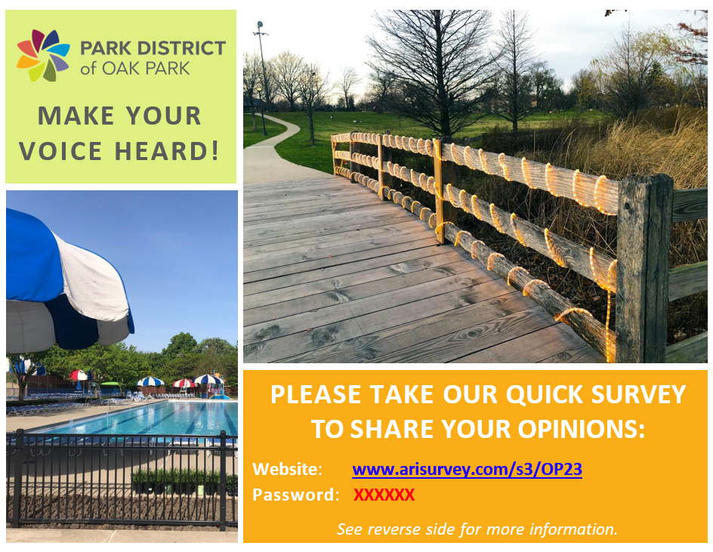
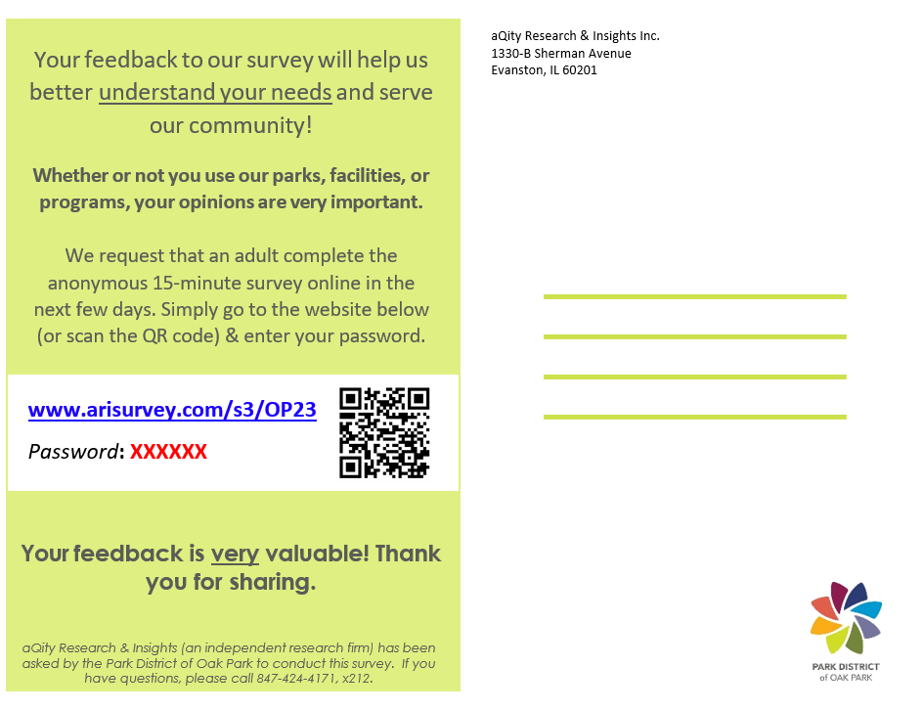
Postcard Invitation

Slide 92
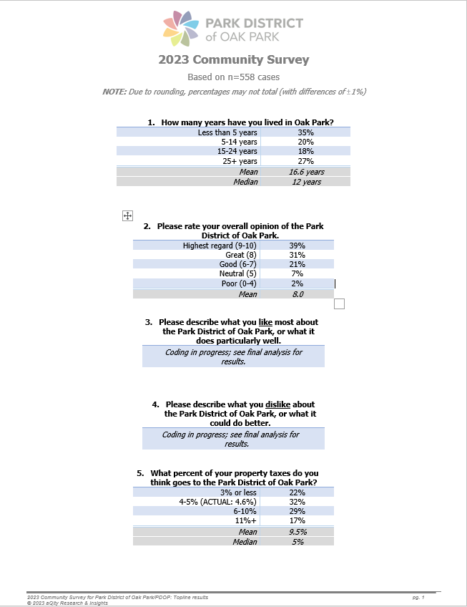
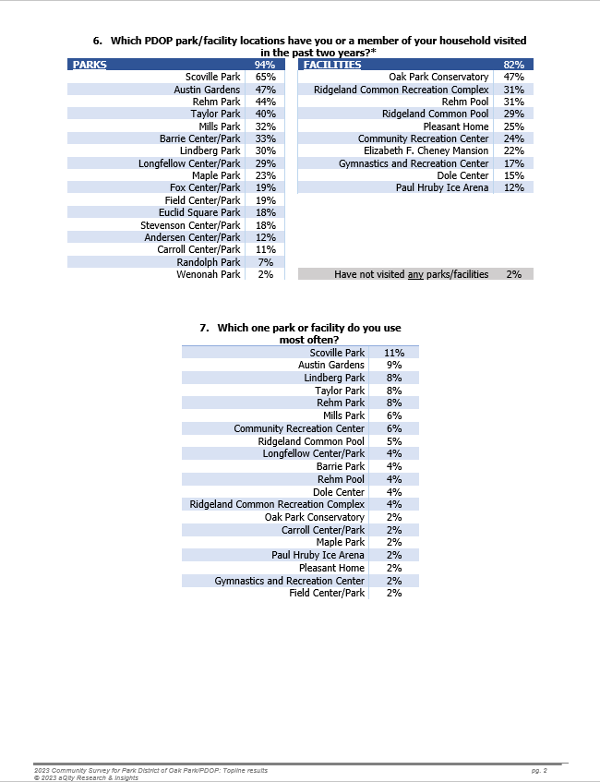
Survey Topline Report

Slide 93
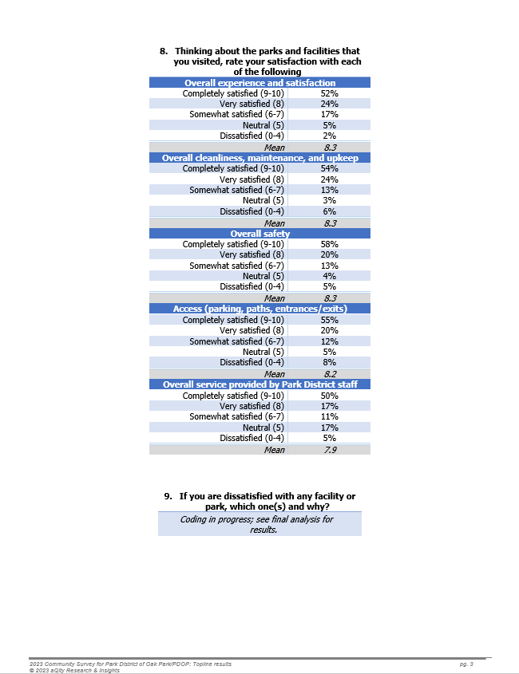
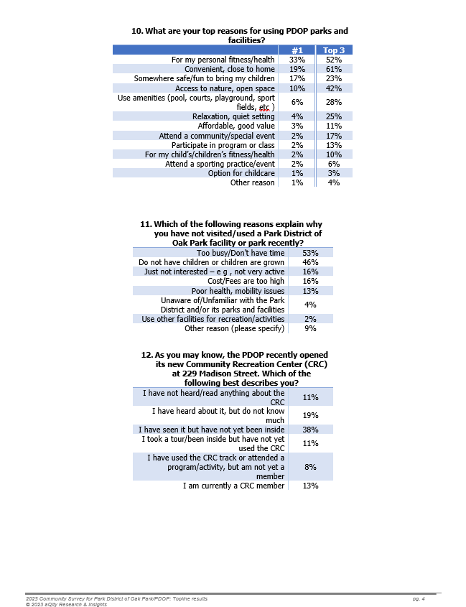
Survey Topline Report

Slide 94
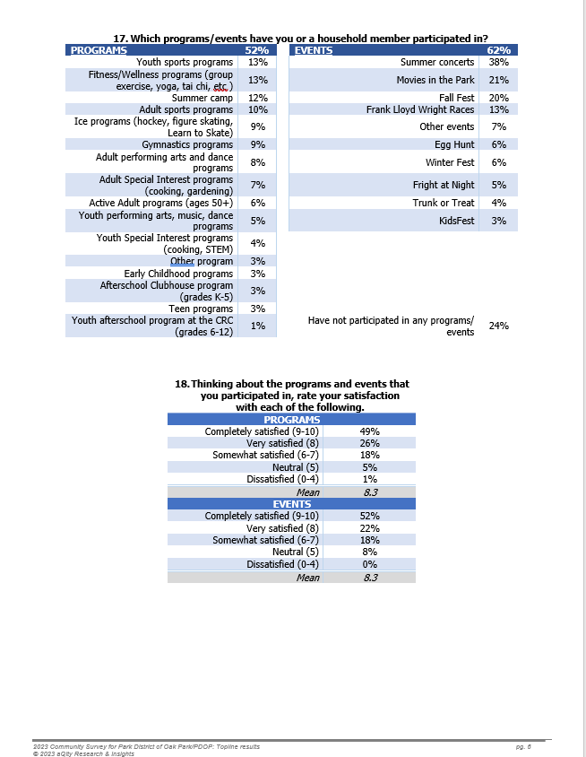
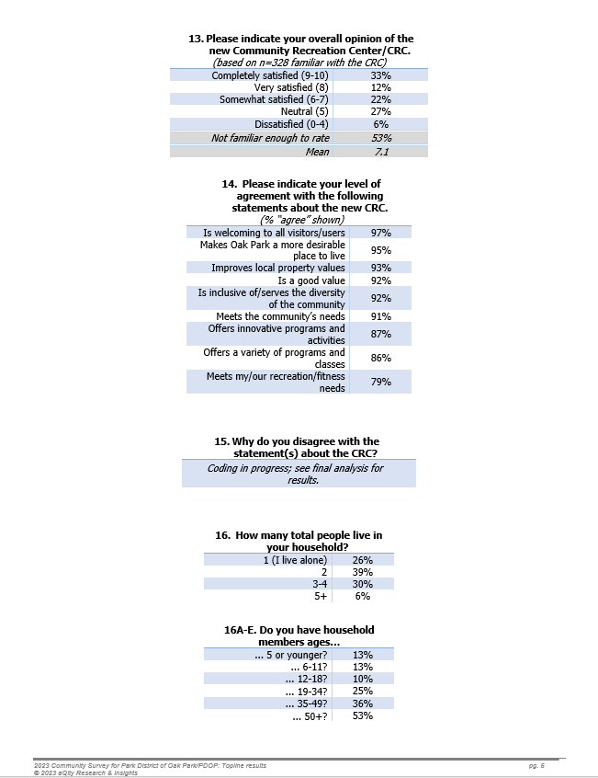
Survey Topline Report

Slide 95
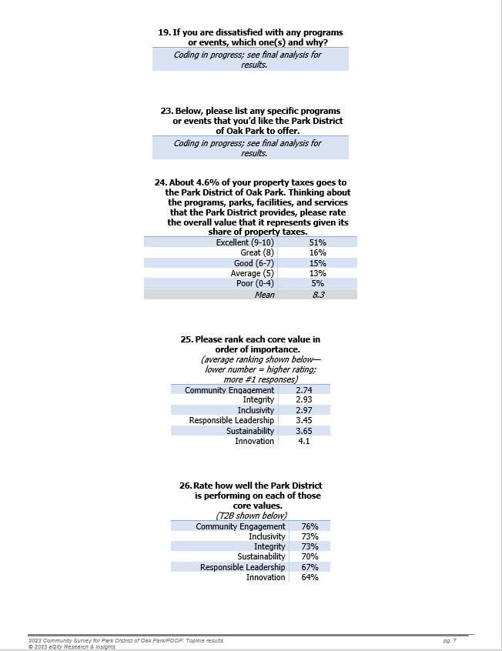
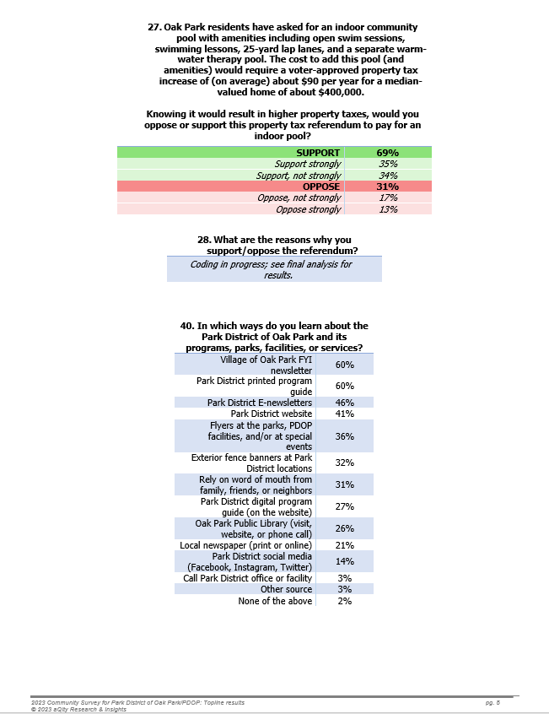
Survey Topline Report

Slide 96
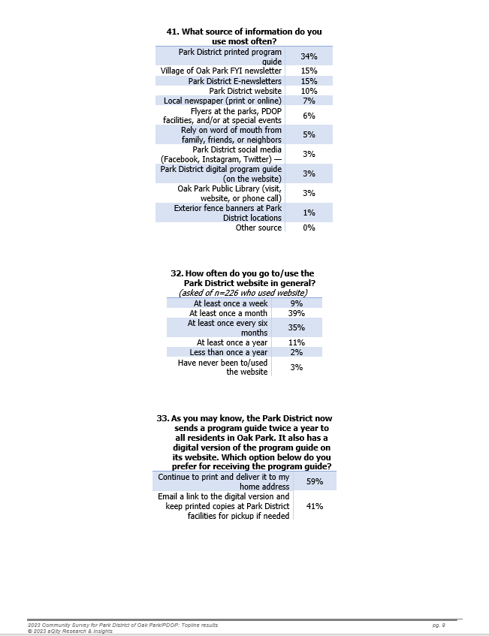
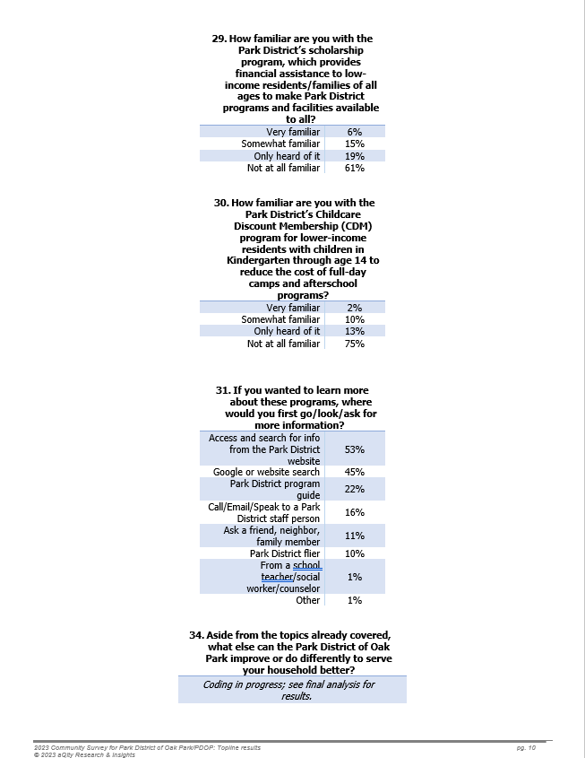
Survey Topline Report

Slide 97
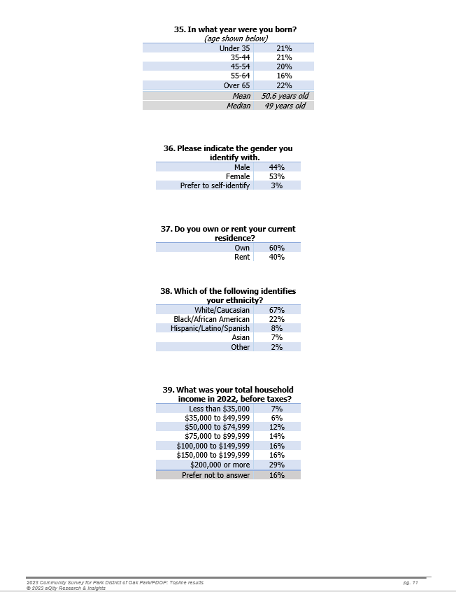
Survey Topline Report

